Slide 1
Plume Rise

Slide 2
Purpose of Air Quality Modeling
Policy Analysis
Regional Planning
Supplementary Control Systems / Air Quality Prediction System
Emergency Preparedness / Accidental Releases
Long Range Transport (Acid Rain)
State Implementation Plan Revisions / New Source Review
Prevention of Significant Deterioration ( PSD )

Slide 3
Atmospheric Transport
Basic Mechanisms in the Movement of a Plume
Advection
Dispersion
Treatment of Concentration Field
Theoretical Approach
Statistical theory
Similarity theory
K-Theory Models
Higher Order Closure Models
Experimental Approach
Wind tunnel/ Water tank
Field Studies (Expensive, Time Consuming & Limitation of Instrumentation )

Slide 4
Types of Air Quality Models
Types of air quality models
Emission rate Modeling
Ambient Air Concentration Modeling
Types of ground level concentration models
Physical Model / Mathematical Model
Historical Model
Trend Model
Prototype Model

Slide 5
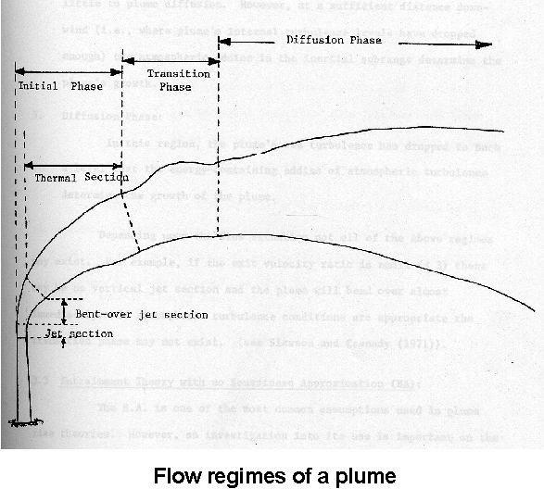
Basic Segments of an Elevated Plume

Slide 6
Basic Segments of An Elevated Plume
Initial phase
Vertical Jet : Effluents are not deflected immediately upon entering the cross flow if (Vs / U > 4 )
Bent-Over Jet Section : Entrainment of the cross flow is rapid because by this time appreciable growth of vortices has taken place.
Thermal Section : Self generated turbulence causes mixing and determines the growth of plume.
Transition phase
Plume's internal turbulence levels have dropped enough so that the atmospheric eddies in the inertial sub range determines the plume's growth.
Diffusion phase
The plume's own turbulence has dropped and energy containing eddies of atmospheric turbulence determine the growth of plume

Slide 7
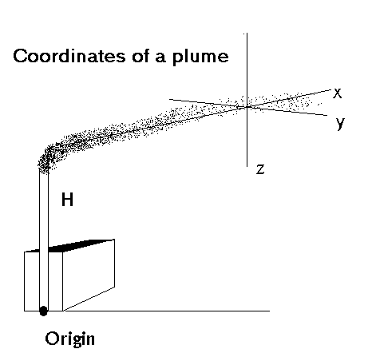

Slide 8
Dispersion of Heavy Gases
Initial Acceleration Phase
Initial Dilution Phase
Slumping Phase (internal buoyancy-dominated dispersion )
Transition Phase
Passive Phase ( atmospheric turbulence-dominated dispersion )

Slide 9
Types of Plume
Continuous Plume: The release and the sampling time are long compared with the travel time.
Puff Diffusion / Instantaneous Plume: The release time or sampling time is short when compared with the travel time
Types of Plume Rise
Buoyancy Effect: Rise due to the temperature difference between stack plume and ambient air.
Momentum Rise: Rise due to exit velocity of the effluents (emissions).

Slide 10
Concept of Plume Penetration
Meteorology plays an important role in the dispersion of effluents.
Various meteorological factors affect the dispersion of emission into the atmosphere in a variety of ways.
Convective boundary layer (or mixing height) is one of the most important meteorological variables responsible for high ground level concentrations.

Slide 11
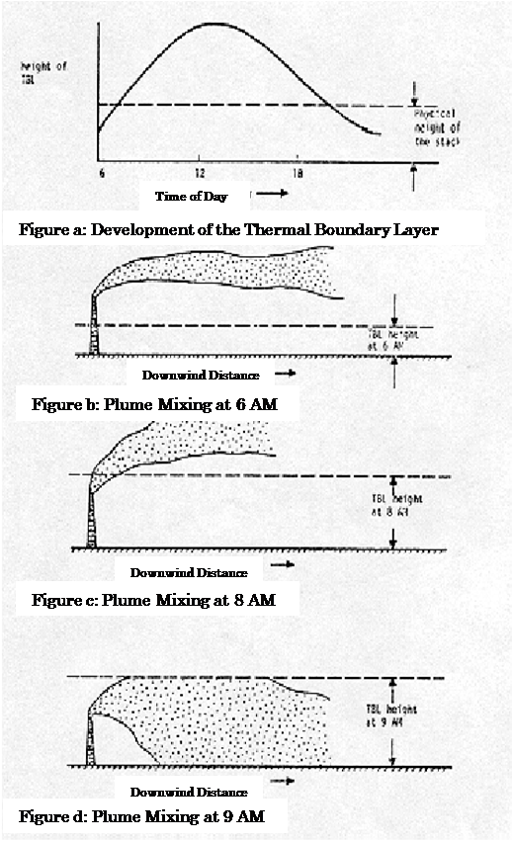
Concept of Plume Penetration

Slide 12
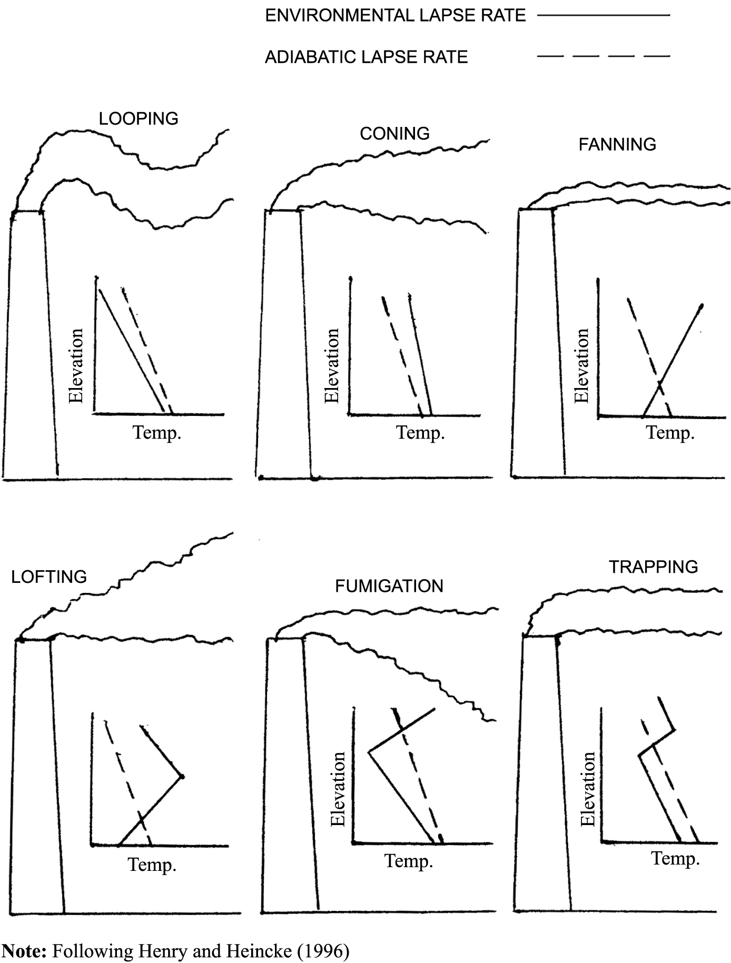
Effect of Temperature Profile on Plume Rise

Slide 13
Plume Rise Models
Semi empirical equations based on heat flux
Analytical solutions
Numerical models

Slide 14
TERMS USED IN PLUME RISE CALCULATIONS
Buoyancy Flux (F):
Momentum Flux (F_{m}):
g = Acceleration due to gravity
V_{s} = Stack exit velocity
d = Exit gas diameter
T_{s} = Stack gas exit temperature
T_{a} = Ambient air temperature

Slide 15
Stability Parameter
Where,

Slide 16
Analytical Solutions
Momentum Sources
For Unstable and Neutral conditions
For Stable conditions
The lower value of the above equations is used for the concentration calculations.

Slide 17
Analytical Solutions
Buoyant plumes
For Unstable and Neutral conditions
x* = 14 F ^{5/8} when F < = 55 m⁴/sec³
x* = 34 F ^{2/5} when F > 55 m⁴/sec³
3.5x* = Downwind distance to the point of final rise
For Stable conditions
The distance to final rise is given by

Slide 18
Determination of the Type of Plume (Momentum or Buoyant)
Crossover Temperature (DT_{c})
Unstable or Neutral case
Buoyancy rise if DT >= DT_{c} or is assumed to be Momentum
Stable case
The above calculations are valid for cases with stack exit temperature T_{s} greater than or equal to ambient temperature T_{a}.

Slide 19
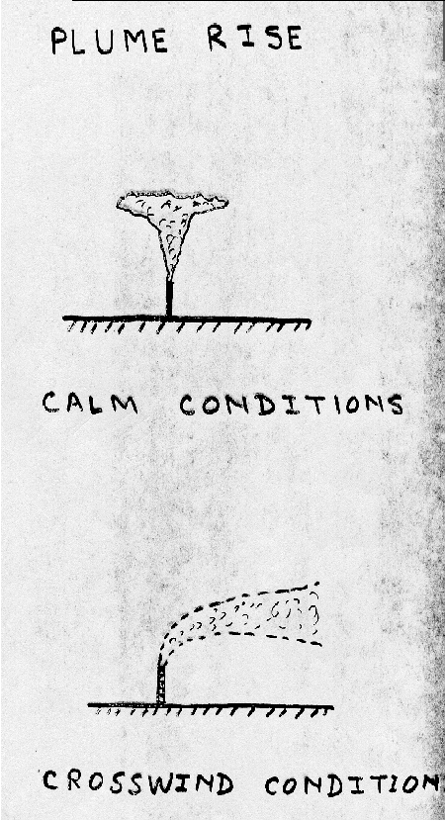
Plumes Under Calm Conditions and Jets
For Calm Conditions
For wind speeds < 1 m/sec
The plume rise for a jet is computed
as follows:
∆h = 4.0 F_{m} ^{1/4} S ^{-1/4}

Slide 20
Calculate the buoyancy flux of a source for the following conditions:
Vs | 19 m/s
ds | 3m
Ts | 400 °K
Ta | 283 °K

Slide 21
Solution
Step 1: ΔT = Ts – Ta
Step 2:
Buoyancy Flux F = (g * Vs * ds² * ∆T )/ (4 * Ts)
F = 122.67 m⁴/s³

Slide 22
Determine the plume rise from a 40 m high stack if the buoyancy flux from the source is 50 m⁴/sec³ and the wind velocity is 5 m/sec. The atmospheric condition is slightly unstable.

Slide 23
Solution
Step 1: Determine if the plume is buoyant or momentum.
Step 2: x* = 14 F ^{5/8} when F < = 55 m⁴/sec³
x* = 161.43
Step 3:

Slide 24
Semi-Empirical Equations
Most of the plume rise equations in this category are based on the following equations
where,
Q_{h} is the heat emission rate of the source
Q_{h} = Q_{m} C_{p} (T_{s} - T_{a})
where,
Q_{m} is the total mass emission rate
Q_{m} = (Π/4) ρ_{s} d² V_{s}

Slide 25
Numerical Models
Conservation of Mass
Conservation of Moisture
Conservation of Energy (Heat)
Conservation of Momentum

Slide 26
Numerical Models
Conservation of Horizontal Momentum
Conservation of Solid Particles

Slide 27
Relationship between Plume Rise z, Downwind Distance x and Time t
Hydrostatic Environment - No Liquid or Solid Particulate Matter
Assumptions made in developing the above equations
Boussinesq approximation has not been used
Solid body effects are included only in the horizontal direction
Downwash is neglected during computations i.e. W_{e} = 0

Slide 28
Problems

Slide 29
PROBLEM
Stack Diameter - 2.24 m
Stack Height - 61.00 m
Stack Exit Velocity - 20.00 m/sec
Stack Exit Temperature - 1000.00 ° K
Atmospheric Temperature - 281.00 ° K
Emission Rate - 348.26 g/sec
Wind Speed at stack height - 5.70 m/sec
Calculate the plume rise for stable, unstable, and neutral atmospheric conditions.

Slide 30
Procedure
Calculate F
Calculate ∆T_{c}
Decide buoyancy/momentum/calm
Choose the plume rise equation
Calculate ∆h

Slide 31
PROBLEM
The wind and stack gas speeds are 3 m/sec at 10 m and 6 m/sec, respectively. The stack diameter is 2 m. The atmospheric condition is near neutral with an average temperature of 300 ° K. The stack gas temperature is 450 ° K. Estimate plume rise. The stack height is 50 m.

Slide 32
FLARE STACK
Flare Length as per API
L = 0.006 Q^{0.478}
where,
L = Flare length (ft)
Q = Flared gas heat release (BTU/hr)
Vertical Height of Flame
h_{fv} = L Sin θ θ = 45 °
Plume Rise
H_{e} = h_{s} + h_{fv} + Δh

Slide 33
Introduction of plume rise
Plume rise - the height to which a plume emitted from an elevated source will rise.
Importance: to the estimation of ambient pollutant concentration, impact on the local and distant environment.
Affected by: the initial sources conditions (exit velocity and temperature difference between the plume and the air), the stable class and stratification of the atmosphere, and the wind field.

Slide 34
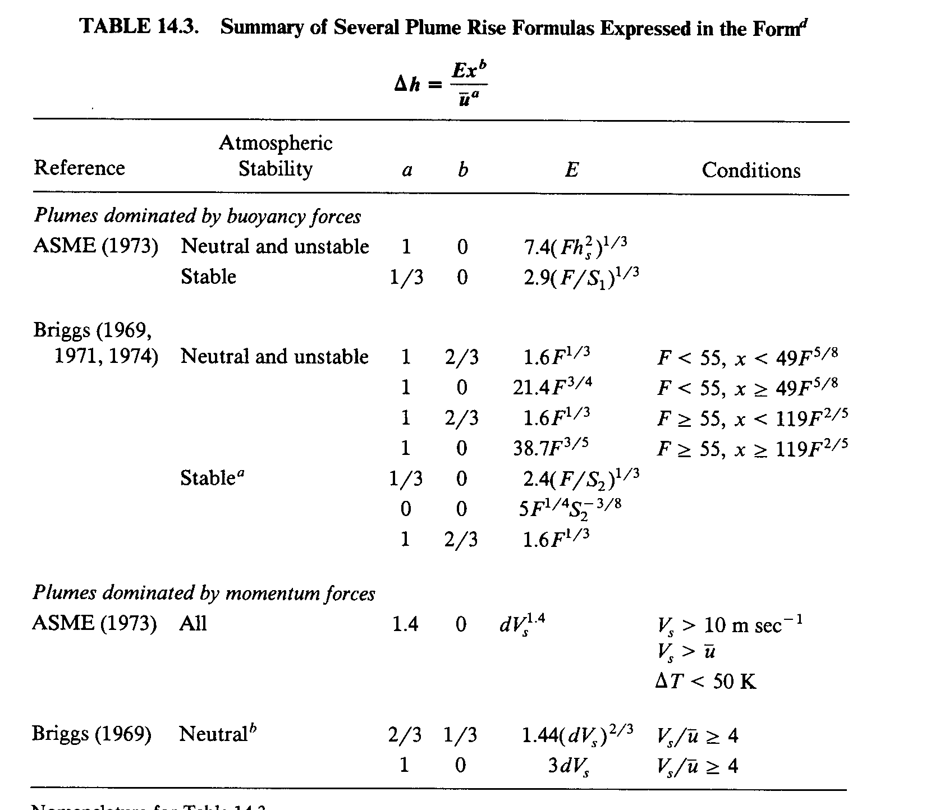
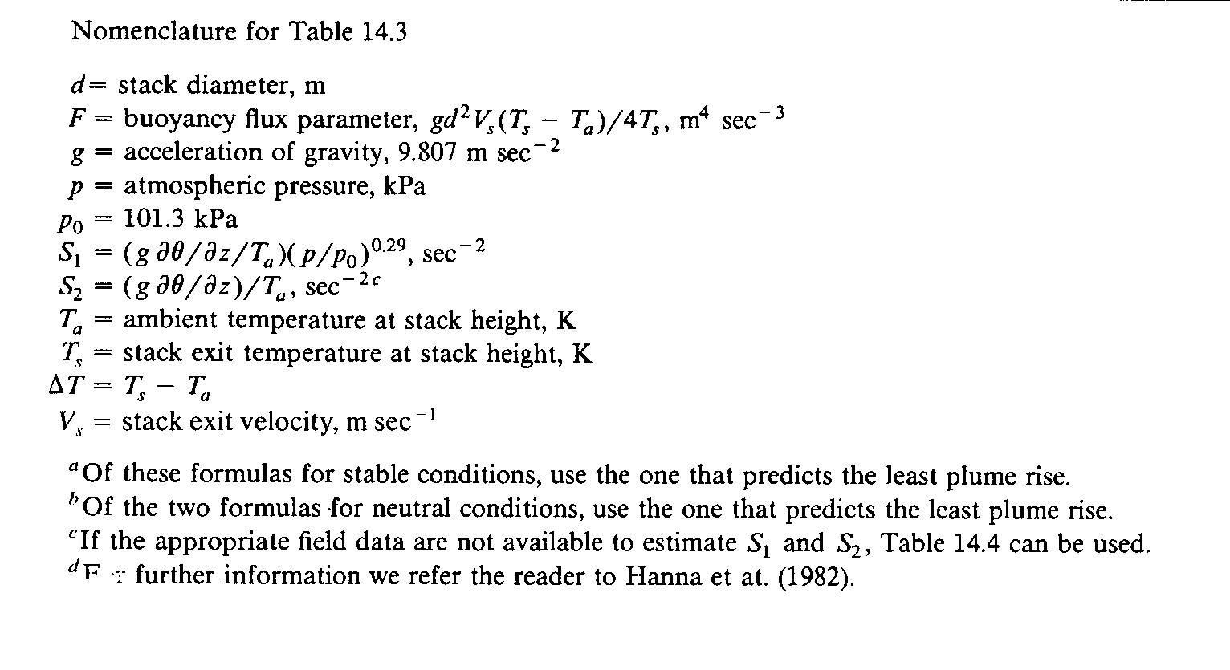
General calculation of plume rise
Basic formulas of plume rise

Slide 35
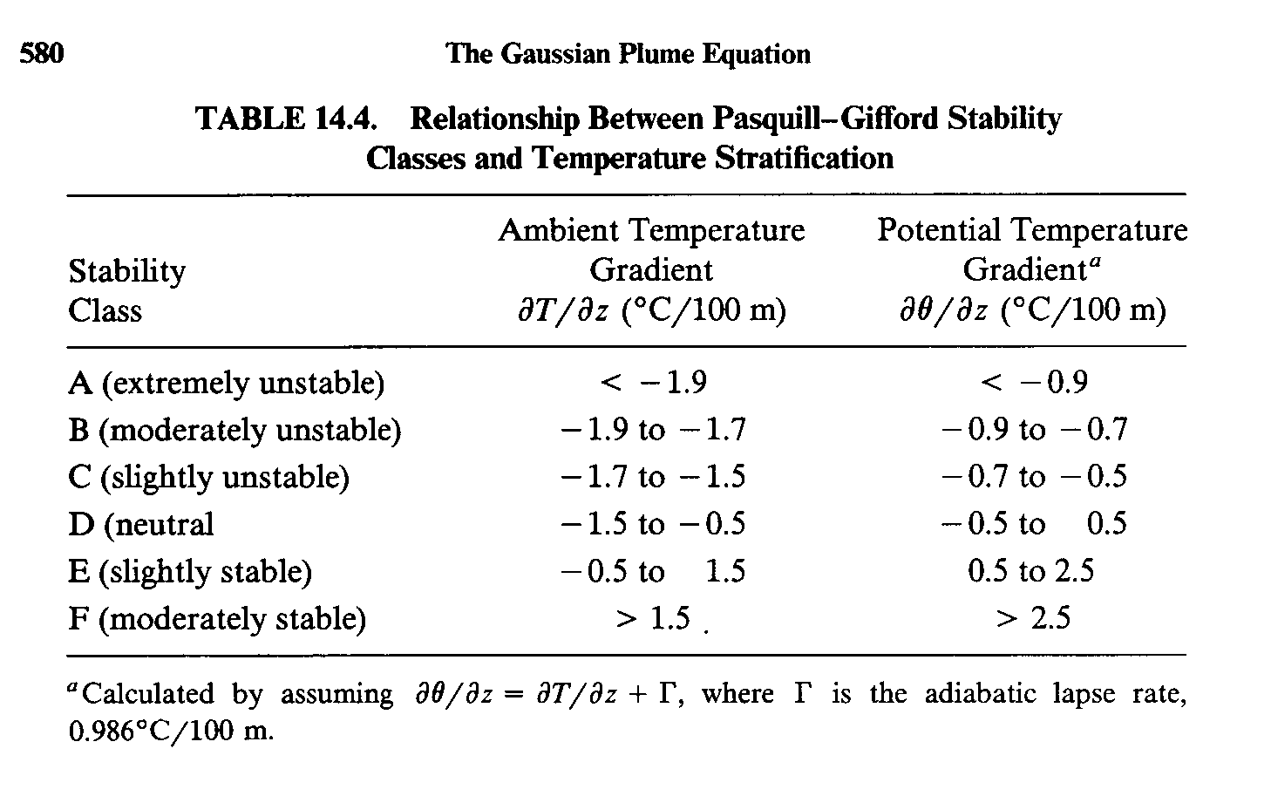
General calculation of plume rise (con’t)

Slide 36
Calculation of fire-plume rise
Features of wild land fire plume
- can not be treated in the same sense as those stack
point sources, but usually be considered as an area
source.
- with a low initial momentum, the wildfire plume rise is
dominated by the buoyancy.
- continue near-surface release.

Slide 37
Calculation of fire-plume rise
Basic equation
Δh : the plume rise of fire plume, m
x: the downward distance,
r₀: fire radius, m
K: the velocity ratio, ( )
U 10-m wind speed, m/s
β : the entrainment coefficient (β=0.6)
F : the Froude number,
w₀ : the initial vertical velocity, m/s
ρ _{a}: ambient density, kg/m3
Δρ: the initial density difference between ambient air and the fire plume. (ρ_{a}-ρ_{p})
T_{P}, T_{a} : temperature of plume and ambient respectively, K
r_{P}: the radius of fire, m
Q_{h}: the heat release rate, J/s

Slide 38
Different cases of calculation of fire-plume rise
Stable conditions
Plume rise is limited by thermal stratification
Δh_{f} is the final rise, m
N is the Brunt Vasaila frequency

Slide 39
Different cases of calculation of fire-plume rise (con’t)
Neutral conditions
Ambient turbulence limits the final plume rise by breaking up the plume
(Briggs, 1984)
u*: friction velocity, m/s

Slide 40
Different cases of calculation of fire-plume rise (con’t)
Unstable conditions
Plume rise is also limited by turbulence
(Briggs, 1989; Weil, 1988)
z_{i} : inversion height, m
w*: the convection velocity scale, m/s

