Slide 1
Hazardous-Toxıc AIr Pollutants

Slide 2
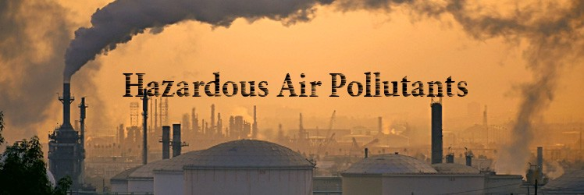
What are Hazardous AIr Pollutants?
Hazardous air pollutants, also known as toxic air pollutants or air toxics, are those pollutants that are known or suspected to cause cancer or other serious health effects, such as reproductive effects or birth defects, or adverse environmental effects.
EPA is working with state, local, and tribal governments to reduce air emissions of 187 toxic air pollutants to the environment.

Slide 3
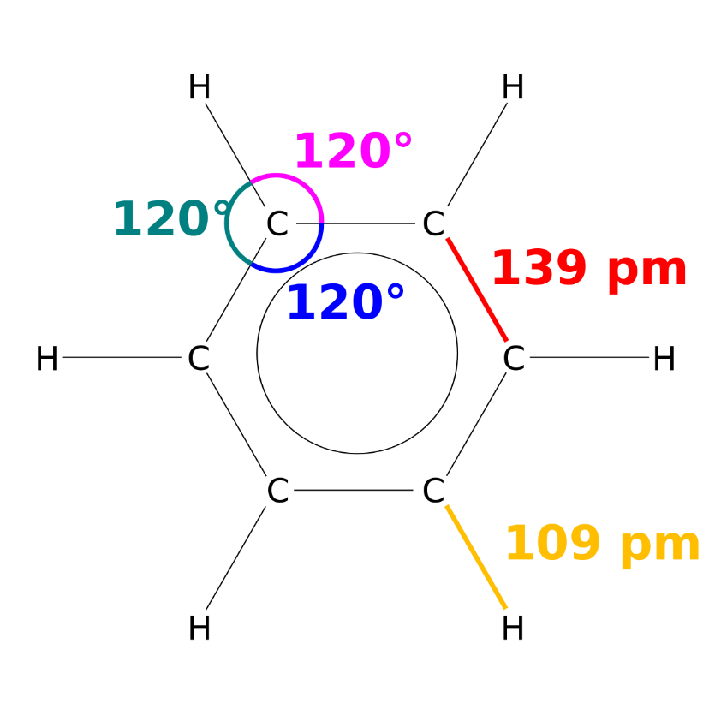
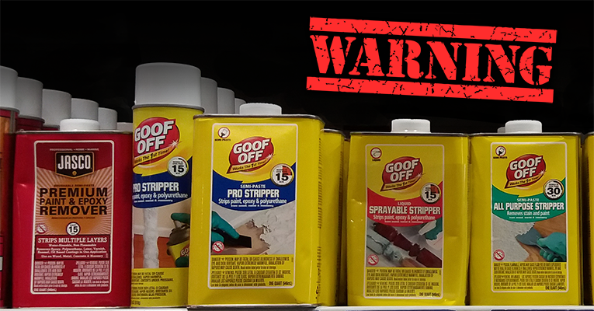
Examples of toxic air pollutants include
benzene, which is found in gasoline;
perchloroethylene, which is emitted from some dry cleaning facilities; and
methylene chloride, which is used as a solvent and paint stripper by a number of industries.
Examples of other listed air toxics include dioxin, asbestos, toluene, and metals such as cadmium, mercury, chromium, and lead compounds.

Slide 4
108316 | Maleic anhydride
67561 | Methanol
72435 | Methoxychlor
74839 | Methyl bromide (Bromomethane)
74873 | Methyl chloride (Chloromethane)
71556 | Methyl chloroform (1,1,1-Trichloroethane)
78933 | Methyl ethyl ketone (2-Butanone) (See Modification)
60344 | Methyl hydrazine
74884 | Methyl iodide (Iodomethane)
108101 | Methyl isobutyl ketone (Hexone)
624839 | Methyl isocyanate
80626 | Methyl methacrylate
1634044 | Methyl tert butyl ether
101144 | 4,4-Methylene bis(2-chloroaniline)
75092 | Methylene chloride (Dichloromethane)
101688 | Methylene diphenyl diisocyanate (MDI)
101779 | 4,4'-Methylenedianiline
91203 | Naphthalene
98953 | Nitrobenzene
92933 | 4-Nitrobiphenyl
100027 | 4-Nitrophenol
79469 | 2-Nitropropane
684935 | N-Nitroso-N-methylurea
62759 | N-Nitrosodimethylamine
59892 | N-Nitrosomorpholine
56382 | Parathion
82688 | Pentachloronitrobenzene (Quintobenzene)
87865 | Pentachlorophenol
108952 | Phenol
106503 | p-Phenylenediamine
75445 | Phosgene
7803512 | Phosphine
7723140 | Phosphorus
85449 | Phthalic anhydride
1336363 | Polychlorinated biphenyls (Aroclors)
1120714 | 1,3-Propane sultone
57578 | beta-Propiolactone
123386 | Propionaldehyde
114261 | Propoxur (Baygon)
108383 | m-Xylenes
106423 | p-Xylenes
0 | Antimony Compounds
0 | Arsenic Compounds (inorganic including arsine)
0 | Beryllium Compounds
0 | Cadmium Compounds
0 | Chromium Compounds
0 | Cobalt Compounds
0 | Coke Oven Emissions
0 | Cyanide Compounds ¹
0 | Glycol ethers ² (See Modification)
0 | Lead Compounds
0 | Manganese Compounds
0 | Mercury Compounds
0 | Fine mineral fibers ³
0 | Nickel Compounds
0 | Polycyclic Organic Matter ⁴
0 | Radionuclides (including radon) ⁵
0 | Selenium Compounds
78875 | Propylene dichloride (1,2-Dichloropropane)
75569 | Propylene oxide
75558 | 1,2-Propylenimine (2-Methyl aziridine)
91225 | Quinoline
106514 | Quinone
100425 | Styrene
96093 | Styrene oxide
1746016 | 2,3,7,8-Tetrachlorodibenzo-p-dioxin
79345 | 1,1,2,2-Tetrachloroethane
127184 | Tetrachloroethylene (Perchloroethylene)
7550450 | Titanium tetrachloride
108883 | Toluene
95807 | 2,4-Toluene diamine
584849 | 2,4-Toluene diisocyanate
95534 | o-Toluidine
8001352 | Toxaphene (chlorinated camphene)
120821 | 1,2,4-Trichlorobenzene
79005 | 1,1,2-Trichloroethane
79016 | Trichloroethylene
95954 | 2,4,5-Trichlorophenol
88062 | 2,4,6-Trichlorophenol
121448 | Triethylamine
1582098 | Trifluralin
540841 | 2,2,4-Trimethylpentane
108054 | Vinyl acetate
593602 | Vinyl bromide
75014 | Vinyl chloride
75354 | Vinylidene chloride (1,1-Dichloroethylene)
1330207 | Xylenes (isomers and mixture)
95476 | o-Xylenes
75218 | Ethylene oxide
96457 | Ethylene thiourea
75343 | Ethylidene dichloride (1,1-Dichloroethane)
50000 | Formaldehyde
76448 | Heptachlor
118741 | Hexachlorobenzene
87683 | Hexachlorobutadiene
77474 | Hexachlorocyclopentadiene
67721 | Hexachloroethane
822060 | Hexamethylene-1,6-diisocyanate
680319 | Hexamethylphosphoramide
110543 | Hexane
302012 | Hydrazine
7647010 | Hydrochloric acid
7664393 | Hydrogen fluoride (Hydrofluoric acid)
7783064 | Hydrogen sulfide (See Modification)
123319 | Hydroquinone
78591 | Isophorone
58899 | Lindane (all isomers)
CAS Number | Chemical Name
75070 | Acetaldehyde
60355 | Acetamide
75058 | Acetonitrile
98862 | Acetophenone
53963 | 2-Acetylaminofluorene
107028 | Acrolein
79061 | Acrylamide
79107 | Acrylic acid
107131 | Acrylonitrile
75252 | Bromoform
106990 | 1,3-Butadiene
156627 | Calcium cyanamide
105602 | Caprolactam (See Modification)
133062 | Captan
63252 | Carbaryl
75150 | Carbon disulfide
56235 | Carbon tetrachloride
463581 | Carbonyl sulfide
120809 | Catechol
133904 | Chloramben
57749 | Chlordane
7782505 | Chlorine
79118 | Chloroacetic acid
532274 | 2-Chloroacetophenone
132649 | Dibenzofurans
96128 | 1,2-Dibromo-3-chloropropane
84742 | Dibutylphthalate
106467 | 1,4-Dichlorobenzene(p)
91941 | 3,3-Dichlorobenzidene
111444 | Dichloroethyl ether (Bis(2-chloroethyl)ether)
542756 | 1,3-Dichloropropene
62737 | Dichlorvos
111422 | Diethanolamine
121697 | N,N-Dimethylaniline
64675 | Diethyl sulfate
119904 | 3,3-Dimethoxybenzidine
60117 | Dimethyl aminoazobenzene
107051 | Allyl chloride
92671 | 4-Aminobiphenyl
62533 | Aniline
90040 | o-Anisidine
1332214 | Asbestos
71432 | Benzene (including benzene from gasoline)
92875 | Benzidine
98077 | Benzotrichloride
100447 | Benzyl chloride
92524 | Biphenyl
117817 | Bis(2-ethylhexyl)phthalate (DEHP)
542881 | Bis(chloromethyl)ether
108907 | Chlorobenzene
510156 | Chlorobenzilate
67663 | Chloroform
107302 | Chloromethyl methyl ether
126998 | Chloroprene
1319773 | Cresols/Cresylic acid (isomers and mixture)
95487 | o-Cresol
108394 | m-Cresol
106445 | p-Cresol
98828 | Cumene
94757 | 2,4-D, salts and esters
3547044 | DDE
334883 | Diazomethane
119937 | 3,3'-Dimethyl benzidine
79447 | Dimethyl carbamoyl chloride
68122 | Dimethyl formamide
57147 | 1,1-Dimethyl hydrazine
131113 | Dimethyl phthalate
77781 | Dimethyl sulfate
534521 | 4,6-Dinitro-o-cresol, and salts
51285 | 2,4-Dinitrophenol
121142 | 2,4-Dinitrotoluene
123911 | 1,4-Dioxane (1,4-Diethyleneoxide)
122667 | 1,2-Diphenylhydrazine
106898 | Epichlorohydrin (l-Chloro-2,3-epoxypropane)
106887 | 1,2-Epoxybutane
140885 | Ethyl acrylate
100414 | Ethyl benzene
51796 | Ethyl carbamate (Urethane)
75003 | Ethyl chloride (Chloroethane)
106934 | Ethylene dibromide (Dibromoethane)
107062 | Ethylene dichloride (1,2-Dichloroethane)
107211 | Ethylene glycol
151564 | Ethylene imine (Aziridine)

Slide 5
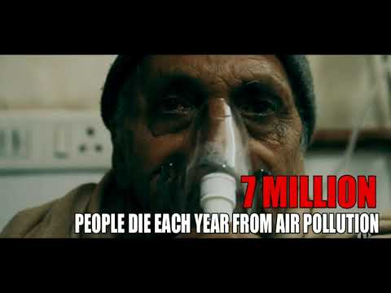
Health and EnvIronmental Effects of Hazardous AIr Pollutants
People exposed to toxic air pollutants at sufficient concentrations and durations may have an increased chance of getting cancer or experiencing other serious health effects.
These health effects can include damage to the immune system, as well as neurological, reproductive (e.g., reduced fertility), developmental, respiratory and other health problems.

Slide 6
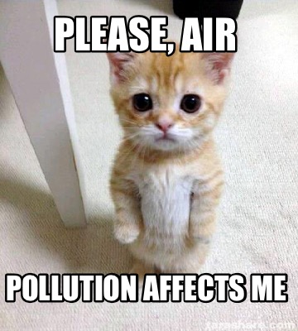
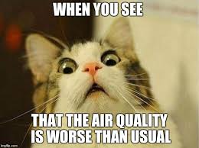
In addition to exposure from breathing air toxics, some toxic air pollutants such as mercury can deposit onto soils or surface waters, where they are taken up by plants and ingested by animals and are eventually magnified up through the food chain.
Like humans, animals may experience health problems if exposed to sufficient quantities of air toxics over time.

Slide 8
Where do hazardous aIr pollutants come from?
Most air toxics originate from human-made sources, including mobile sources (e.g., cars, trucks, buses) and stationary sources (e.g., factories, refineries, power plants), as well as indoor sources (e.g., some building materials and cleaning solvents).
Some air toxics are also released from natural sources such as volcanic eruptions and forest fires.

Slide 9
Drinking water contaminated by toxic air pollutants.
Ingesting contaminated soil. Young children are especially vulnerable because they often ingest soil from their hands or from objects they place in their mouths.
Touching (making skin contact with) contaminated soil, dust, or water (for example, during recreational use of contaminated water bodies).

Slide 10
Once toxic air pollutants enter the body, some persistent toxic air pollutants accumulate in body tissues.
Predators typically accumulate even greater pollutant concentrations than their contaminated prey.
As a result, people and other animals at the top of the food chain who eat contaminated fish or meat are exposed to concentrations that are much higher than the concentrations in the water, air, or soil.

Slide 11
What Is BeIng Done to Reduce Hazardous AIr Pollutants?
EPA and partners have taken significant steps to dramatically reduce toxic air pollutants and provide important health protections for Americans nationwide.
These steps include:
reducing toxic emissions from industrial sources;
reducing emissions from vehicles and engines through new stringent emission standards and cleaner burning gasoline;
and addressing indoor air pollution though voluntary programs.

Slide 12
Urban AIr ToxIcs
Reducing emissions of urban air toxics has been a priority for EPA since the passage of the Clean Air Act Amendments in 1990.
In the last two decades we've seen significant reductions in urban air toxics as a result of regulations and enforcement actions.
Even with this progress, additional work remains to improve our understanding of urban air toxics and to effectively reduce remaining risks, particularly in overburdened communities.

Slide 13
What are urban aIr toxIcs?
Air toxics, also known as toxic air pollutants or hazardous air pollutants, are those pollutants that cause or may cause cancer or other serious health effects, such as reproductive effects or birth defects, or adverse environmental and ecological effects.

Slide 14
Identify a subset of 30 HAPs that present the greatest threat to public health in the largest number of urban areas. These 30 HAPs are known as the 30 urban air toxics.
Identify area sources that represent 90 percent of the combined emissions of the 30 urban air toxics, and subject these sources to regulation. The EPA identified 68 area source categories of urban air toxics.

Slide 15
Health effects of urban air toxics
Air toxics tend to pose greater risks in urban areas because these areas have large populations and a higher concentration of emission sources.
Combined exposures from all sources of air pollution, including major stationary sources, smaller area sources, indoor sources and mobile sources can increase public health risks from air toxics..

Slide 16
Low-income neighborhoods, tribal populations and communities that live in urban areas may be disproportionately exposed to air pollution, which is a barrier to economic opportunity and security

Slide 17
Urban AIr ToxIc Pollutants
List of 30 Urban Air Toxics
Acetaldehyde | Dioxin | Mercury compounds
Acrolein | Propylene dichloride | Methylene chloride (dichloromethane)
Acrylonitrile | 1,3-dichloropropene | Nickel compounds
Arsenic compounds | Ethylene dichloride (1,2-dichloroethane) | Polychlorinated biphenyls (PCBs)
Benzene | Ethylene oxide | Polycyclic organic matter (POM)
Beryllium compounds | Formaldehyde | Quinoline
1,3-butadiene | Hexachlorobenzene | 1,1,2,2-tetrachloroethane
Cadmium compounds | Hydrazine | Tetrachloroethylene (perchloroethylene)
Chloroform | Lead compounds | Trichloroethylene
Chromium compounds | Manganese compounds | Vinyl chloride

Slide 18
Area Sources of Urban AIr ToxIcs
ist of 68 Area Sources of Urban Air Toxics
Acrylic Fibers/Modacrylic Fibers Production | Iron and Steel Forging
Agricultural Chemicals and Pesticides Manufacturing | Iron Foundries
Aluminum Foundries | Lead Acid Battery Manufacturing
Asphalt Processing and Asphalt Roofing Manufacturing | Medical Waste Incinerators
Autobody Refinishing Paint Shops | Mercury Cell Chlor-Alkali Plants
Carbon Black Production | Miscellaneous Organic NESHAP
Chemical Manufacturing: Chromium Compounds | Municipal Landfills
Chemical Preparations | Municipal Waste Combustors (MWC)
Chromic Acid Anodizing | Nonferrous Foundries
Clay Products Manufacturing (Clay Ceramics Manufacturing) | Oil and Natural Gas Production
Commercial Sterilization Facilities | Paint Stripper

Slide 19
Copper Foundries | Paints and Allied Products Manufacturing
Cyclic Crude and Intermediate Production | Pharmaceutical Production
Decorative Chromium Electroplating | Plastic Materials and Resins Manufacturing
Dry Cleaning Facilities | Plastic Parts and Products (Surface Coating)
Electrical and Electronic Equipment – Finish Operations | Plating and Polishing
Fabricated Metal Products | Polyvinyl Chloride and Copolymers Production
Fabricated Plate Work | Portland Cement
Fabricated Structural Metal Manufacturing | Prepared Feeds Materials
Ferroalloys Production: Ferromanganese & Silicomanganese | Pressed and Blown Glass and Glassware Manufacturing
Flexible Polyurethane Foam Fabrication Operations | Primary Copper (not subject to MACT)
Flexible Polyurethane Foam Production | Primary Metal Products Manufacturing

Slide 20
Gas Distribution Stage 1 | Primary Nonferrous Metals (Zn, Cd and Be)
Halogenated Solvent Cleaners | Public Owned Treatment Works
Hard Chromium Electroplating | Secondary Copper Smelting
Hazardous Waste Incineration | Secondary Lead Smelting
Heating Equipment, Except Electric | Secondary Nonferrous Metals
Hospital Sterilizers | Sewage Sludge Incineration
Industrial Boilers Fired by Coal, Wood and Oil | Stainless and Nonstainless Steel Manufacturing Electric Arc Furnace
Industrial Inorganic Chemical Manufacturing | Stationary Internal Combustion Engines
Industrial Machinery and Equipment – Finish Operations | Steel Foundries
Industrial Organic Chemical Manufacturing | Synthetic Rubber Manufacturing
Inorganic Pigments Manufacturing | Valves and Pipe Fittings
Institutional/Commercial Boilers Fired by Coal, Wood and Oil | Wood Preserving

Slide 21
Samplıng of hazardous aır pollutants

Slide 22
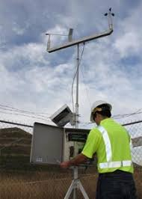
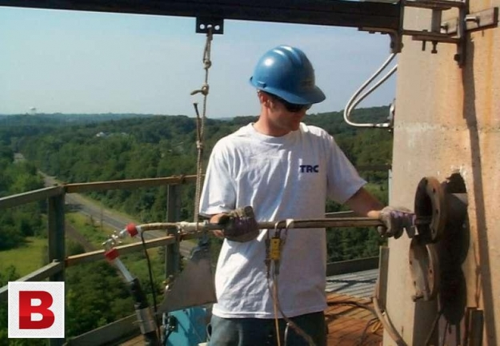
Types of measurements
1) Ambient measurement, Ambient Monitoring
2) Source measurement, source testing
The principal Basis of Air pollution laws depends on Air Quality standard philosophy is to have Air safe to breath

Slide 23
To achieve that: Control and Monitoring of Air pollutants should be implemented.
To control pollutant concentrations:
The time, the place, and the amount of emissions, should be regulated.
The emission rates of various sources of air pollutants must be regulated and measured.

Slide 24
Why measurements are needed?
1) Legal Requirements
2) Evaluation of air pollution control devices

Slide 25
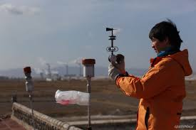
The Aim of Sampling:
The principal requirement of a sampling system is to obtain a sample that is representative of the atmosphere at a particular place and time and that can be evaluated as a mass or volume concentration.
The sampling system should not alter the chemical or physical characteristics of the sample in an undesirable manner.

Slide 26
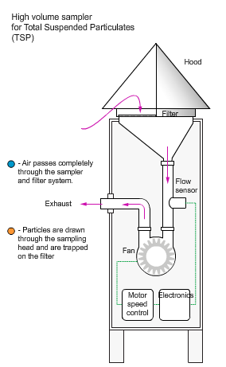
The major components of most sampling systems are:
1) An inlet manifold
2) An Air mover
3) A collection medium
4 ) Flow measurement device

Slide 27
(1) The inlet manifold transports the material from the ambient atmosphere to the collection medium or analytical device in an unaltered condition, all inlet of ambient air must be rainproof.
(2) The air mover provides the force to create a vacuum or lower pressure at the end of the sampling system (pumps).

Slide 28
(3) The collecting medium, may be solid or liquid sorbent for dissolving gases a filter surface for collecting particles.
(4)The flow device measures the volume of air associated with the sampling system.

Slide 29
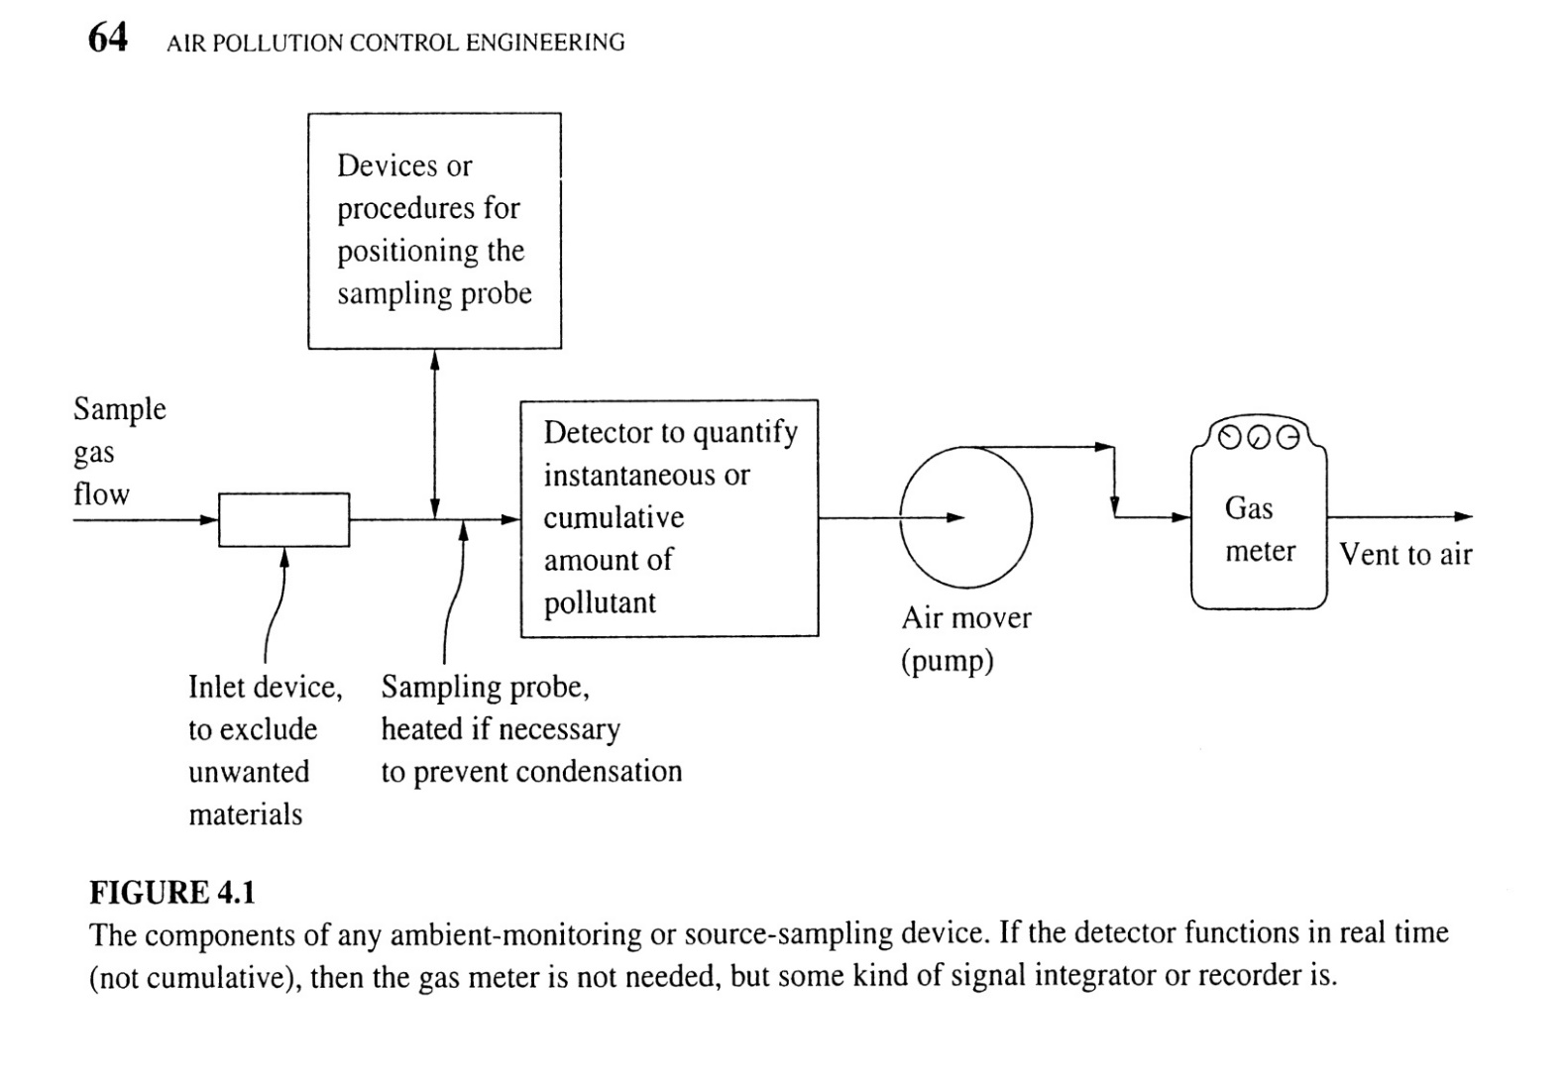

Slide 30
A Representative sample
In Air measurements there are two important problems
1)To obtain the suitable representative sample
2)The determination of the concentration of the pollutant of interest in it correctly.

Slide 31
Example samplıng poınt selection
(1) If the sample was taken from inside parking structure, the result will show great violation of pollutants, specially CO.
(2) If the sample is taken directly across the street from such a structure, in most cases the concentration will be of magnitude less than inside the structure.

Slide 32
(3) A block away, the concentration will be even less.
(4) On the side walk directly adjacent to the structure, the concentration will be may twice as high as on the opposite side of the street.

Slide 33
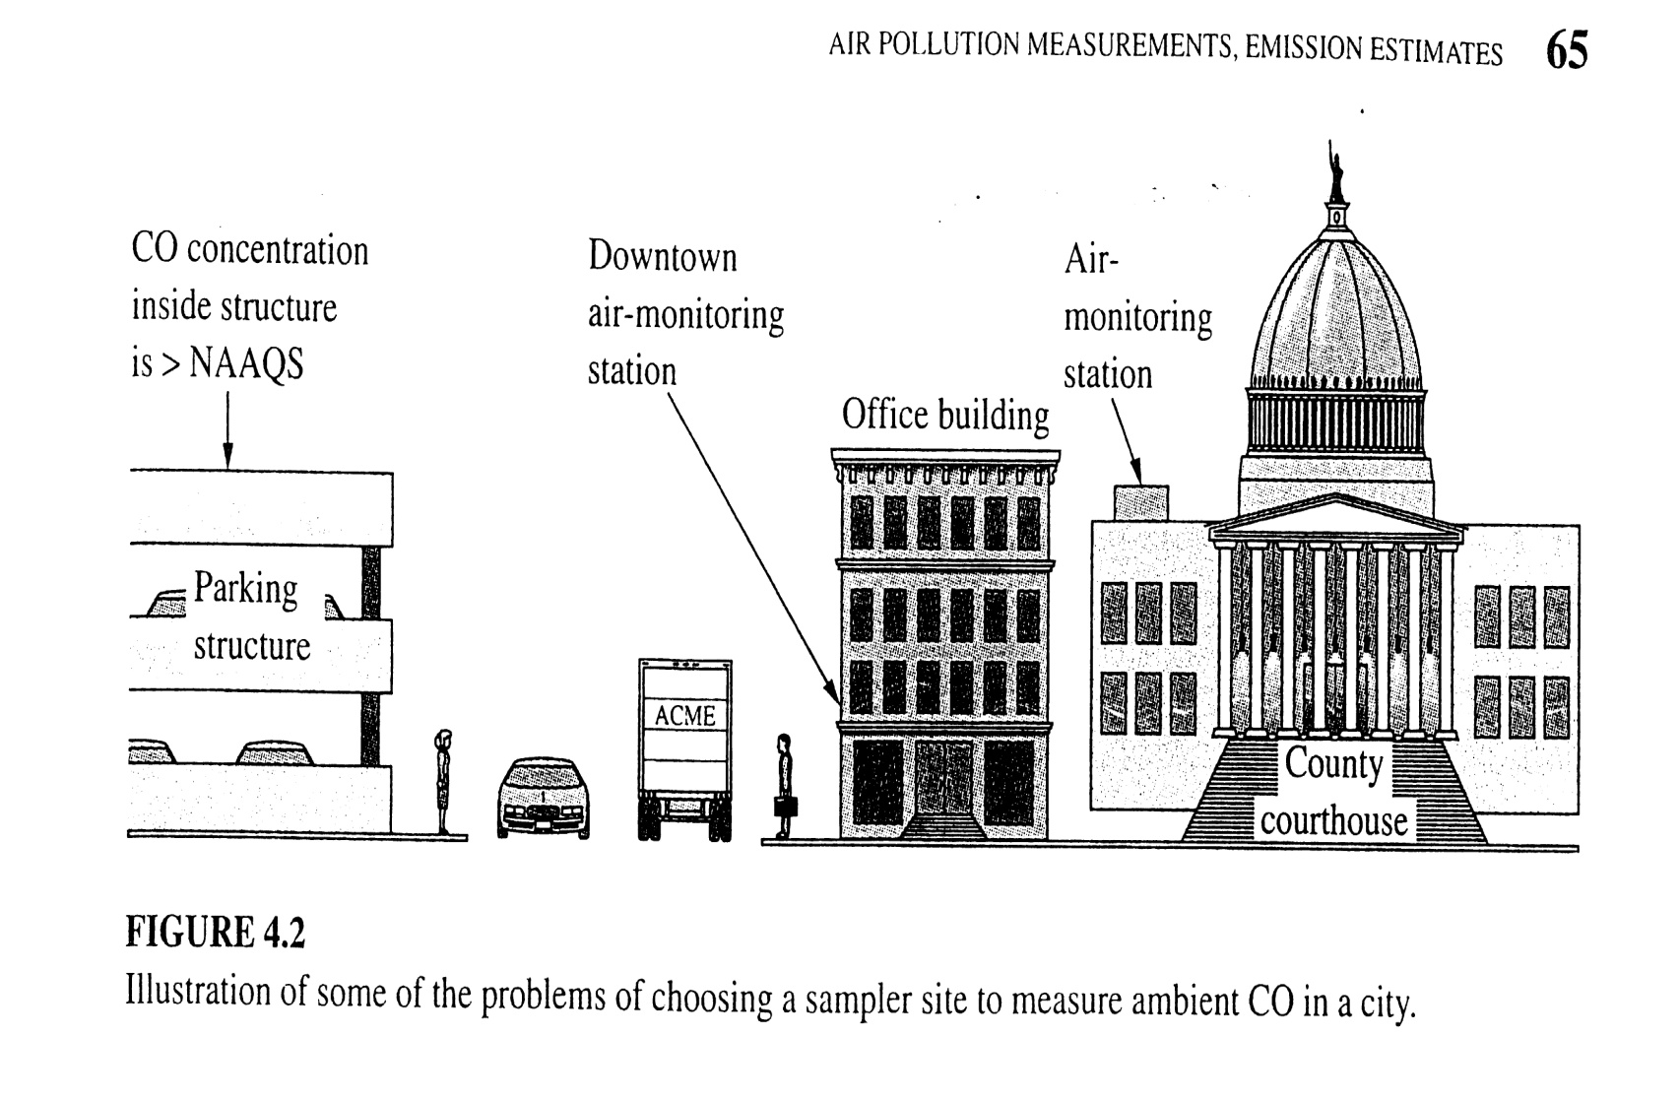

Slide 34
Which of these locations is suitable for obtaining a sample of ambient air?
Generally the ambient air sampler should be located at the place to which the public has free access where the pollutant concentration is highest.
This means that all indoor spaces, which the public has no access are excluded.

Slide 35
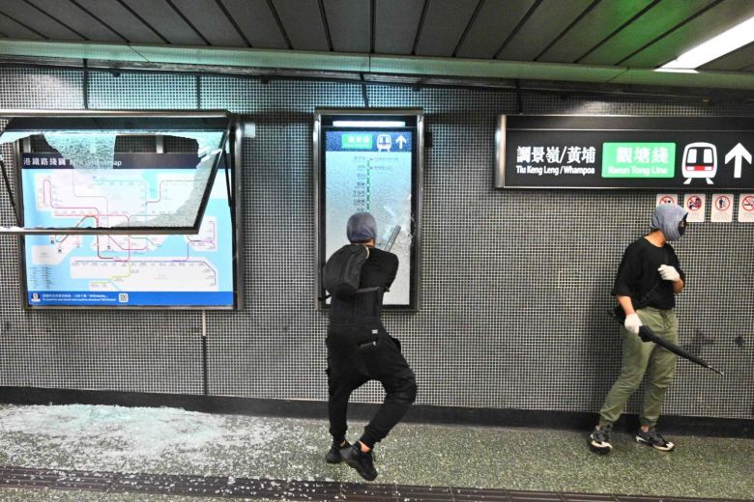
Where we can put an ambient air monitor ?
In Place:
1- has the power
2- shelter from rain and snow
3- constant temp. and pressure
4- easy access from monitoring personnel
5- protection from vandalism
6- if possible free rent place

Slide 36
In the previous case, the suitable place is the roof of county health building or of the county courthouse.
However the concentration of the outer-related pollutants measured there is much lower than at street levels at the busiest intersection downtown.

Slide 37
There are EPA guidelines for the proper placement of intake of air samples that are to represent ambient air, i.e. CO measurements must be made at street level, downtown.

Slide 38
In source testing: The representative sample problem is equally difficult
1- If the gas flow in large industrial smokestack is steady, well mixed across the diameter of the stack. It can be taken a representative sample any time and at any place.
2- Most of such stacks have variation in velocities and concentrations from point to point, and from time to time.

Slide 39
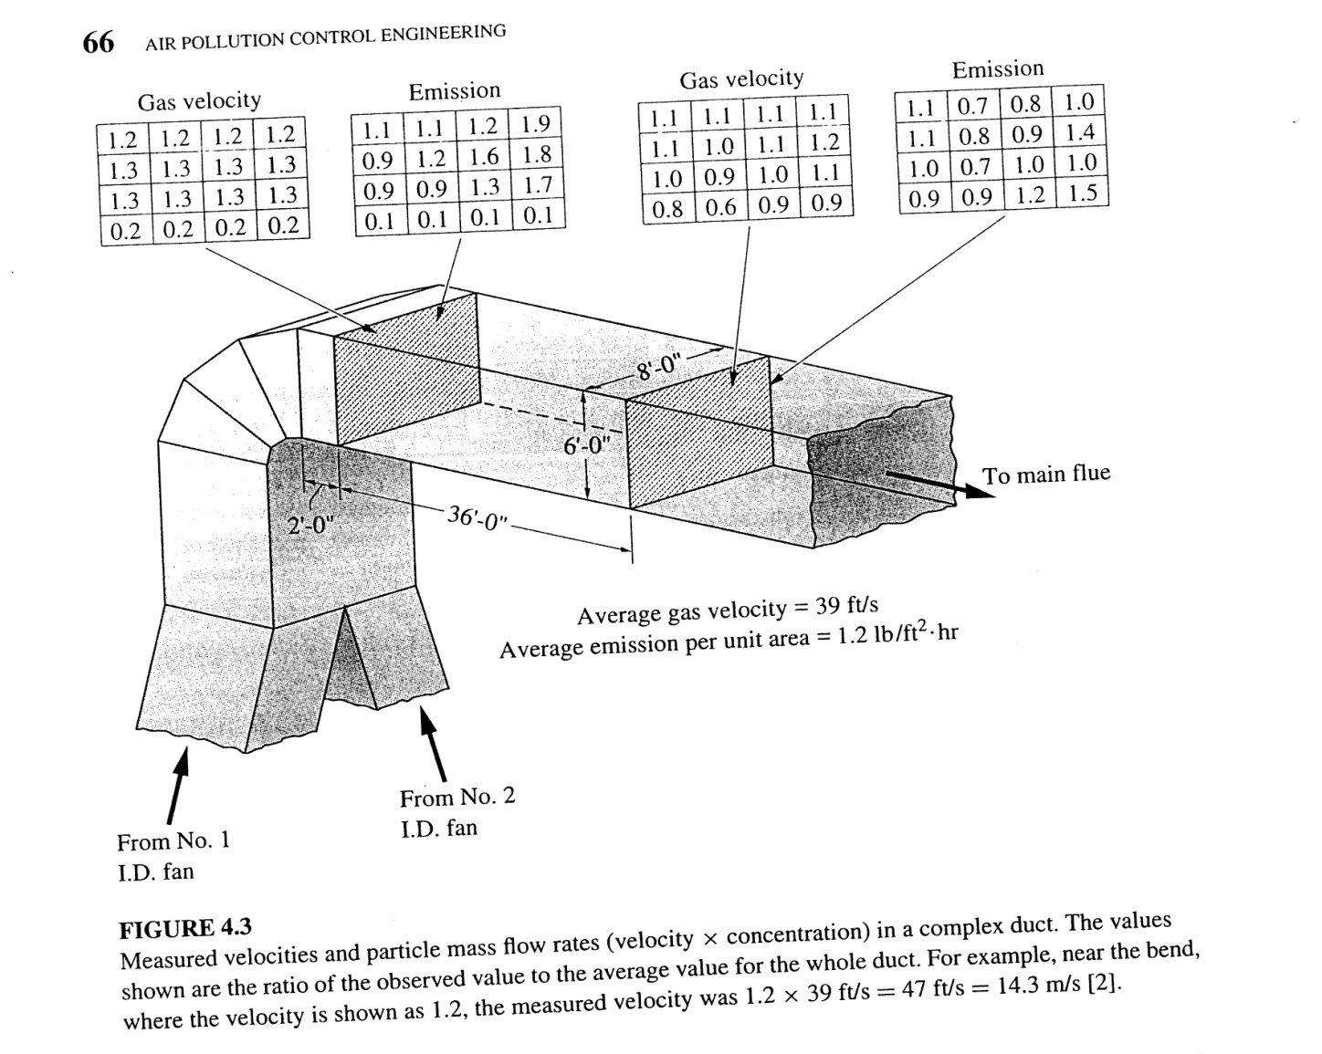
In this case, many separate measurements Must be made and averaged.

Slide 40
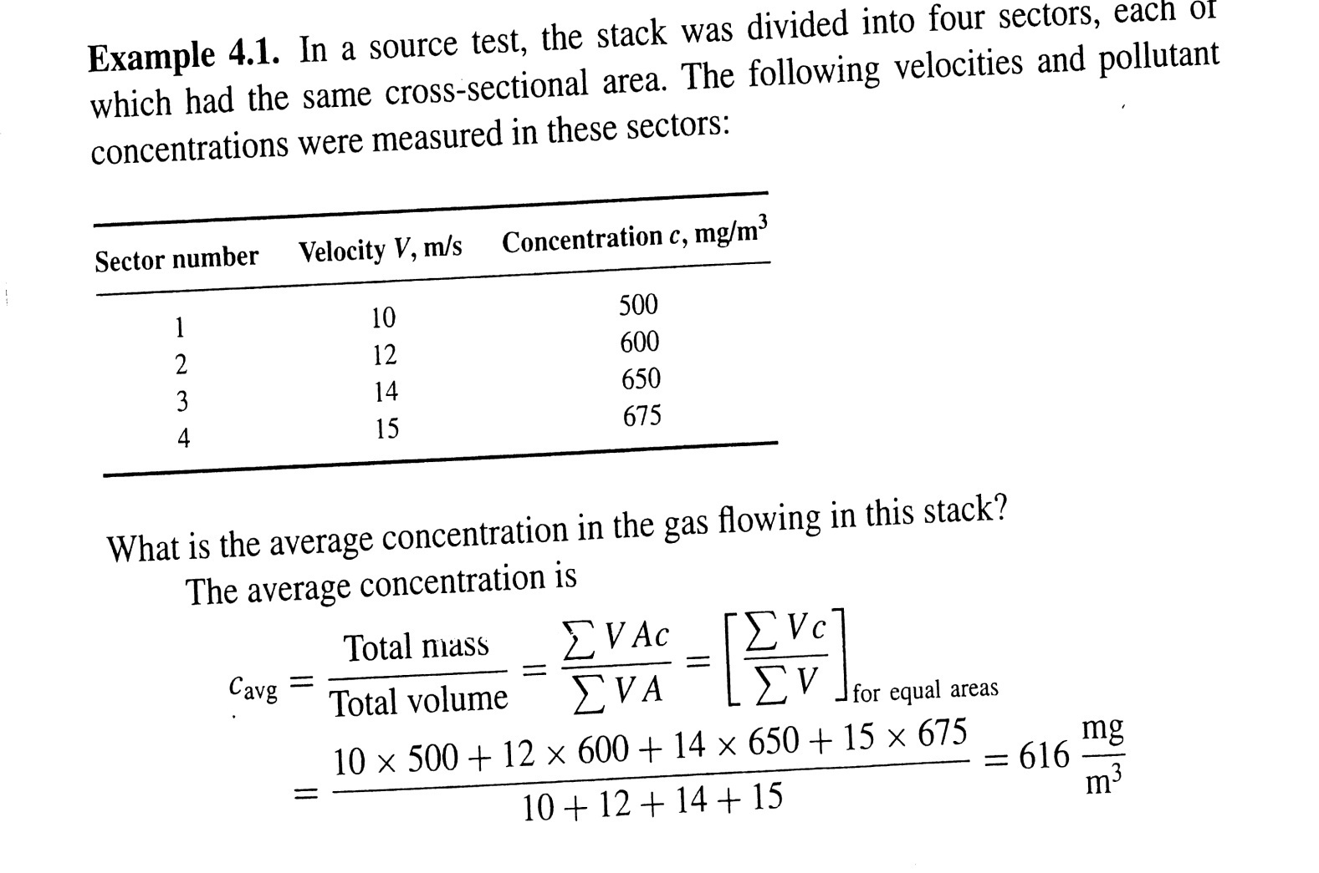

Slide 41
Getting the representative sample to the detector
Many sampling instruments have some kind of devices on the inlet to exclude unwanted materials. i.e.:
Insects sucked into a particulate sampler nozzle lead to erroneously high readings.
-Dust particles of less health concern that weigh more than all of the fine particles.

Slide 42
Consistency between inlet excluding materials and modification of analysis.
EPA modified its particulate samplers in 1987 and in 1997.
Before 1987, the sampler inlet was designed to exclude all particles larger than 50 micron, the quantity sampled was called Total Suspended particulate ( TSP).
The 1987 modification changed the inlet to exclude all particles larger than 10 micron, the quantity sampled is called PM10.

Slide 43
The 1997 modification changed the inlet again to exclude all particles larger than 2.5 micron. (PM2.5 or smaller), and also changed the flow rate.
In sampling device, gases may condense in the sampling device, or react with the solids encounter there.
Many combustion stack gases have a high water content and will condense on the walls of unheated sampling probe. In such cases, probes are normally heated to prevent this.

Slide 44
If a grab sample is to be brought to the lab for analysis, the sample container should be from appropriate material and well pretreated according to the analyte type .
i.e. glass containers can react with some air pollutants.

Slide 45
Concentration Determination
After sampling representatively and correctly, determination of analyte concentration is followed.
For some pollutants, can be measured easily by real time instruments.
Most of these operate optically, due to absorbance and transmittance at a particulate wavelength. i.e. Spectrophotometric methods.

