Slide 1


NATIONAL UNIVERSITY OF SCIENCES & TECHNOLOGY
Notes:
In this presentation I will be briefing you about the impact that NUST has been creating over the last 3 decades in Academia, Research & Development, Innovation and many other avenues.
But before that, we feel honoured to tell you that:
NUST is Pakistan’s only university in top 400 in the world, top 100 Asian & Top 50 Young World Universities
We host country’s first science & technology park,
country’s largest academia-based incubation centre, and country’s first university-based Intellectual Property Office,
We also host country’s first university-based research and production facility for indigenous cardiac stents, catheters and life-supporting medical devices
How we are doing it, we will be presented to you in next 20-25 minutes.

Slide 2
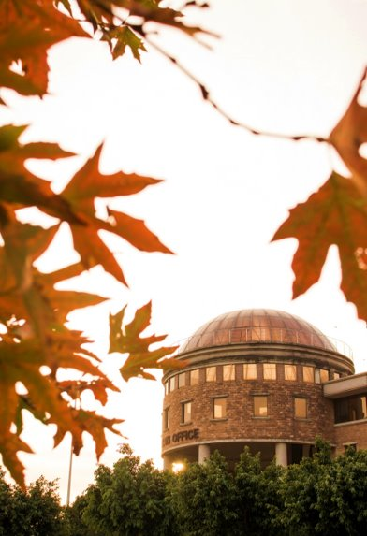


3 DECADES OF EXCELLENCE
Comprehensive
Multidisciplinary
Research Intensive University
1991
ESTABLISHED
5 Military Colleges
MAIN CAMPUS
H-12 ISLAMABAD
2008
+ 7 Institutions & 1 Campus
Truly national footprint
IN ALL 4 PROVINCES
7 CAMPUSES IN 5 CITIES
19 INSTITUTIONS
2022

Slide 3
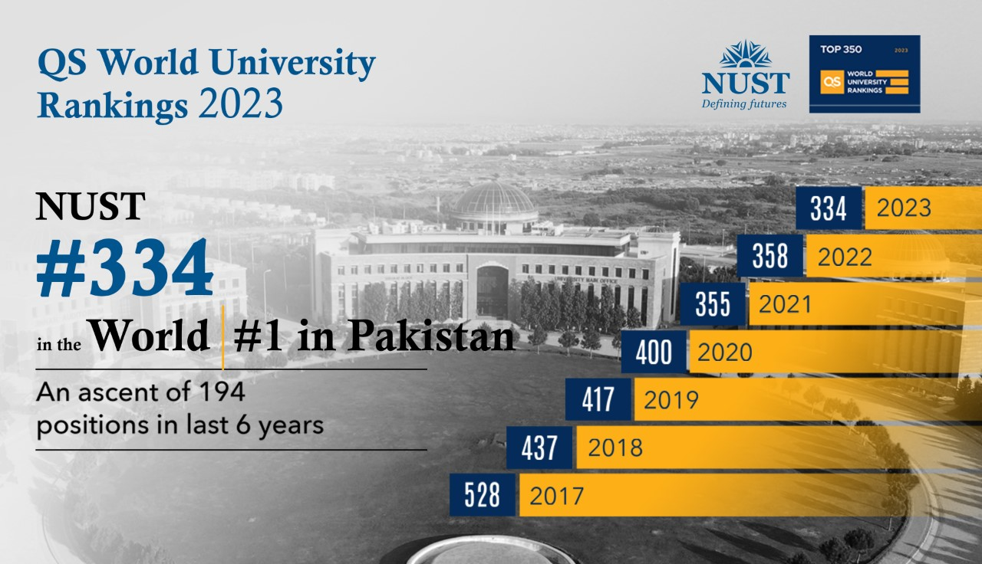

Slide 4
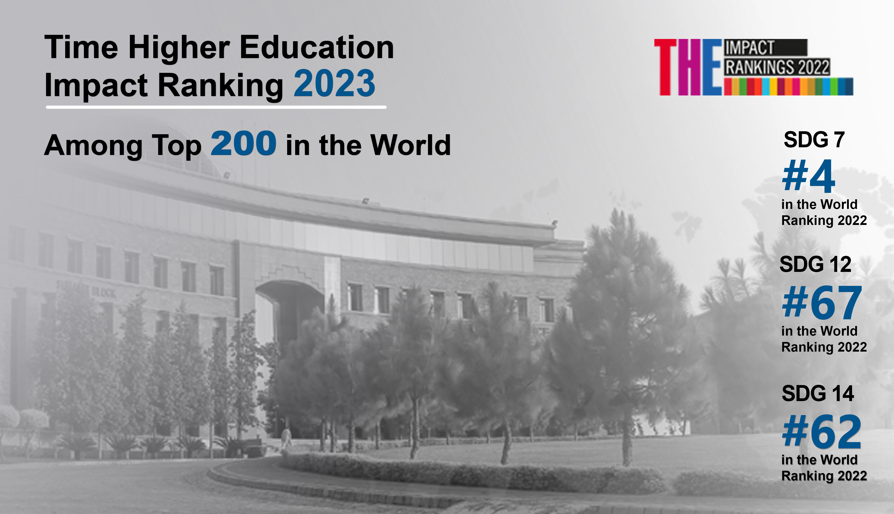
Ranked #1 in Pakistan in 9 SDGs
  SDG 6: Clean Water & Sanitation
  SDG 7: Affordable & Clean Energy
  SDG 9: Industry, Innovation & Infrastructure
  SDG 11: Sustainable Cities & Communities
  SDG 12: Responsible Consumption
  SDG 14: Life below Water
  SDG 15: Life on Land
  SDG 16: Peace, Justice & Strong Institutions
  SDG 17: Partnership for Goals
Ranked #2 in Pakistan in 2 SDGs
  SDG 8: Decent Work & Economic Growth
  SDG 16: Peace, Justice & Strong Institutions
Ranked #3 in Pakistan in 1 SDG
  SDG 10: Reduced Inequalities

Slide 5
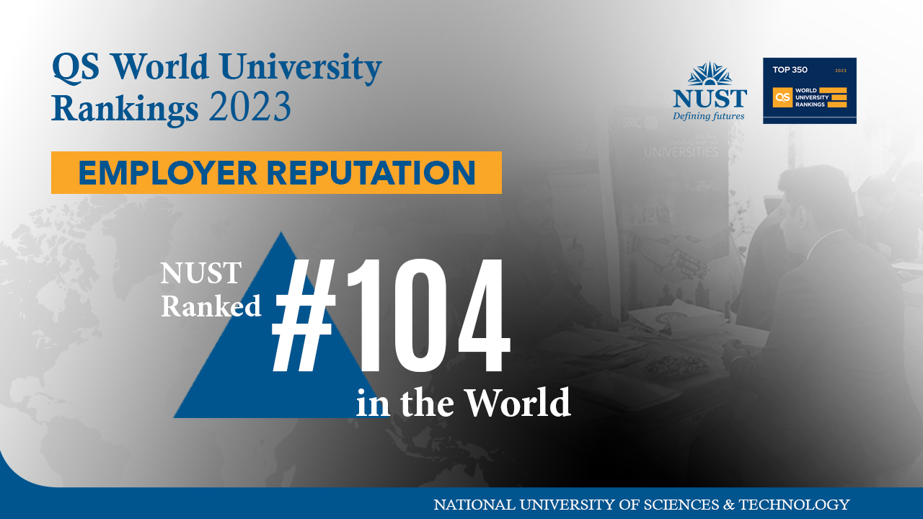

Slide 6





INTELLECTUAL CAPITAL
7 Disciplines
18,500
Current Students
1,495
Faculty
Members
141
Academic
Programmes
30%
Female Students
42,288
Graduates
Washington Accord ratified
(All Engineering programmes)
4% Acceptance Rate*
Alumni Spread
64
Countries
*For UG Students
Notes:
NUST is currently offering 7 disciplines: click
Offering 138 academic programmes currently: click
All 19 engineering programmes of NUST have been ratified with Washington Accord. This helps NUST graduates in employability in 22 member countries as well as it helps in transfer of credits and admission for higher studies into accredited programmes of member countries. Click is optional
Currently + students are studying across our 7 campuses. Click
It is notable that the only criterion for admission into NUST is merit; there is no quota of any sort. NUST has one of the best student acceptance rates in the world i.e. 4%, which is comparable to Ivy League universities – e.g.
acceptance rate at Harvard is 4.7%, Stanford is 4%, MIT is 8%
Oxford: 18%, Cambridge: 12% Imperial college 15% Warwick 14%
NUST has more than 1300 faculty members. Click
NUST has more than 42,000+ graduates till date.
Spread in 64 countries. click

Slide 7







MULTIDISCIPLINARY STRENGTHS
7 Disciplines
Information Technology
Applied Biosciences
Management Sciences
Engineering
Basic/Natural Sciences
Social Sciences & Humanities
Art, Design & Architecture
Back
Notes:
including Engineering, IT, Applied Biosciences, Management Sciences, Basic/Natural Sciences, Social Sciences & Humanities and Art, Design & Architecture

Slide 8
ACADEMIC PROGRAMMES
Year | Undergrad | MS/MPhil | PhD | Total
2002 | 12 | 10 | 10 | 32
2008 | 13 | 21 | 19 | 53
2021 | 31 | 67 | 43 | 141
Back
Notes:
From 2002 to 2021, we have risen from 32 academic programmes to 138 academic programmes, this is an increase of around 3.5 fold in around 20 years.
Multidisciplinary programmes, examples: Mechatronics, MIS, Geo-informatics, Environmental Engineering, Industrial & Manufacturing Engineering, Energy Systems Engineering, Information Security, Biomedical Engineering, Innovative Technologies in Learning, Engineering Management, etc.

Slide 9

WASHINGTON ACORD
INTERNATIONAL ENGINEERING ACCREDIATATION
Full signatory - Pakistan Engineering Council
All NUST’s Engineering programmes ratified
Benefits for NUST Engineering students / graduates
  Transfer of credits & admission for higher studies into the accredited programmes of member countries (22)
    Australia, Canada, China, Costa Rica, Hong Kong, India, Ireland, Japan, Korea, Malaysia, New Zealand, Pakistan, Peru, Philippines, Russia, Singapore, South Africa, Sri Lanka, Taiwan, Turkey, United Kingdom, United States
  Improved employability
BACK
Notes:
Another milestone that we have achieved is the ratification of ALL our 19 Engineering programmes with the Washington Accord. We are the only Pakistani university with all Engineering programmes accredited under WA.
The Washington Accord is an international accreditation agreement for professional engineering academic degrees, between the bodies responsible for accreditation in its signatory countries.
Advantage of this accreditation for our students is that they enjoy transfer of credits and admission for higher studies into accredited programmes of member countries
22 member countries
Australia, Canada, China, Costa Rica, Hong Kong, India, Ireland, Japan, Korea, Malaysia, New Zealand, Pakistan, Peru, Philippines, Russia, Singapore, South Africa, Sri Lanka, Taiwan, Turkey, United Kingdom, United States.
NUST’s 19 Engineering Programmes Accredited by Washington Accord
SMME (1) BE Mechanical
SCME (2) BE Chemical, BE Metallurgy & Materials
SCEE (3) BE Civil (NICE), BE Environment (IESE), BE Geo Informatics (IGIS)
SEECS (2) BE Electrical, BE Software Engineering
MCS (2) BE Electrical, BE Software
CEME (4) BE Electrical, BE Mechanical, BE Mechatronics, BE Computer
MCE (1) BE Civil
CAE (2) BE Avionics, BE Aerospace
PNEC (2) BE Mechanical, BE Electrical

Slide 10
CURRENT STUDENTS
30% female students
Category | UG | MS / MPhil | PhD | Total
2002 | 1,120 | 492 | 9 | 1,621
2008 | 5,190 | 650 | 74 | 5,914
2022 | 11,836 | 5,745 | 840 | 18,421
Back
Notes:
NUST has experienced massive increase in the number of students in UG and PG programmes from 2002 till date.
We have 30% female students enrolled in our programmes (in total), which is quite remarkable.
2,634 UG Female (2020)
2,372 MS Female (2020)
357 PhD Female (2020)
Percentage of female students in American universities::
Harvard: 49.5%
Stanford: 50%
MIT: 46.1%
Purdue: 43%
Percentage of female students in UK universities:
Oxford: average of 51% from 2016-19
Cambridge: average of 48% from 2015-2017

Slide 11
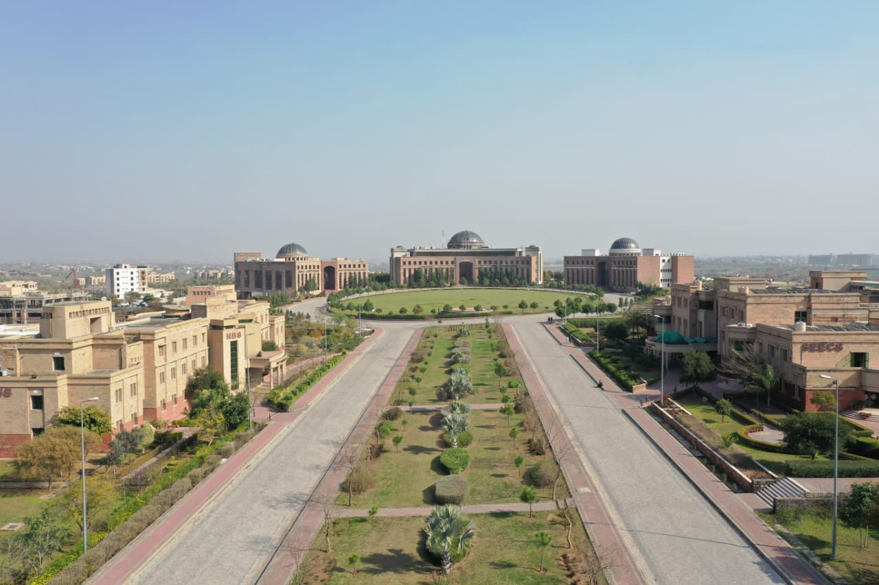












NUST FACULTY
~56% PhD Faculty | 29% Female | 52% Foreign Qualified
UK = 137
Germany = 50
Italy = 22
USA = 87
Malaysia = 49
Sweden = 17
China = 73
Australia = 32
Canada = 14
South
Korea = 43
France = 27
Others = 127
Back
Notes:
We have almost 50% PhD Faculty members.
Out of the total Faculty members, 22% faculty members are female, which is quite remarkable and is comparable globally
49 % of our faculty members are foreign qualified from 35 countries. Few of the countries have been shown on the screen:
‘OTHERS’ include:
Japan=13, Saudi Arabia=12, Turkey=12, Thailand=11, Austria=8, New Zealand=8, Norway=7, Hong Kong=6, Netherlands=6, Singapore=6, Hungary=3, Ireland=3, Portugal=3, Spain=3, Switzerland=3, Denmark=2, Scotland=2, South Africa 2, Bangladesh=1, Brazil=1, Finland=1, Pennsylvania=1, Romania=1, Taiwan=1
Total Faculty members: 1,384* (1,223 Civil + 161 Military) → 89% Civil, 11% Military faculty members
* Incl NUST Regular Faculty (Prof, Assoc Prof, Asst Prof, Lec, RVF, Cst, Lab Engr), Adjunct and Mil Fac
* Incl Active and On Leave Fac
(Data as of September 3, 2021)

Slide 12

INTERNATIONAL ACADEMIC LINKAGES
203 Institutions in
48 Countries

Slide 13
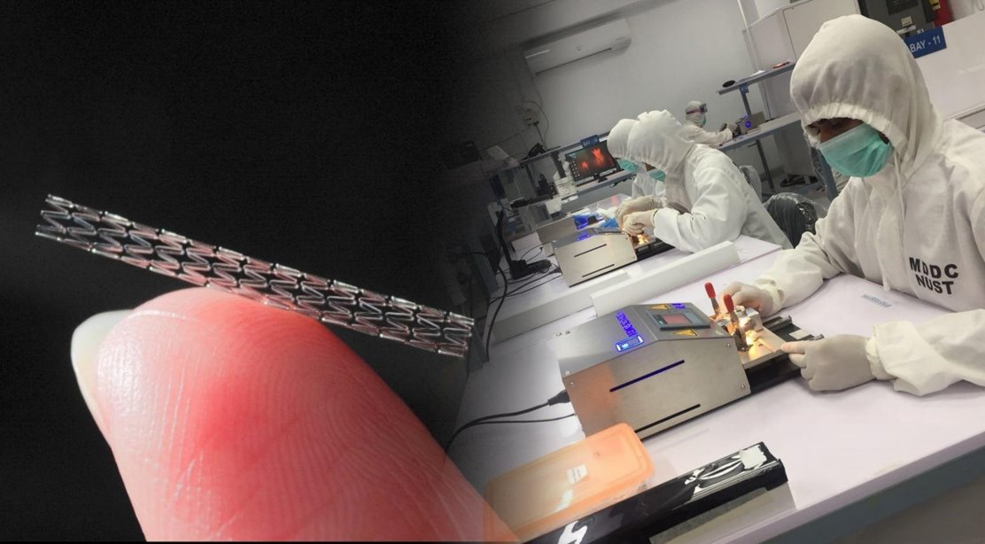







RESEARCH EXCELLENCE
6 SDG-ALIGNED RESEARCH THEMES
60 RESEARCH AREAS
Smart Cities
Green Energy
Health & Well-being, Food & Agriculture
Transformative Technology, Innovation & Shared Value Creation
14,515 Research Publications on WoS
7,144 Joint Research Publications
Digital Futures
Pakistani Society, Business, & Economy
Notes:
In-line with UNDP’s Sustainable development goals (SDGs) & based on Research carried out at NUST in the last 5 years, NUST Research Dte. has identified 6 themes at which NUST has been rigorously conducting Research. Those 6 Themes are flashed on the slide; Each theme comprises of 10-12 related subthemes., and has a number of projects being carried out.. In total 436 research projects have been conducted by NUST in the last 5 years, with funding received from International & National, public & private sector organisations.
It is worth mentioning that the ones being shown here, are only the funded projects. UG and PG student research projects are separate ongoing projects, which is a standard academic parallel activity.

Slide 14

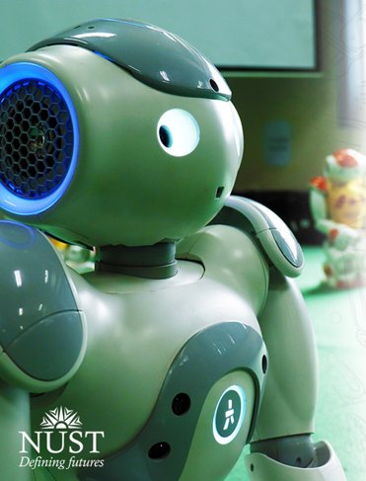




RESEARCH EXCELLENCE
4 NATIONAL CENTRES OF EXCELLENCE ESTABLISHED BY GoP IN PAKISTANI ACADEMIA
2 CENTRES WON BY NUST IN OPEN COMPETITION
LABS OF NUST AT OTHER NATIONAL CENTRES
NATIONAL CENTRE FOR
CYBER SECURITY
NATIONAL CENTRE FOR
BIG DATA & CLOUD
COMPUTING
Notes:
In-line with UNDP’s Sustainable development goals (SDGs) & based on Research carried out at NUST in the last 5 years, NUST Research Dte. has identified 6 themes at which NUST has been rigorously conducting Research. Those 6 Themes are flashed on the slide; Each theme comprises of 10-12 related subthemes., and has a number of projects being carried out.. In total 436 research projects have been conducted by NUST in the last 5 years, with funding received from International & National, public & private sector organisations.
It is worth mentioning that the ones being shown here, are only the funded projects. UG and PG student research projects are separate ongoing projects, which is a standard academic parallel activity.

Slide 15
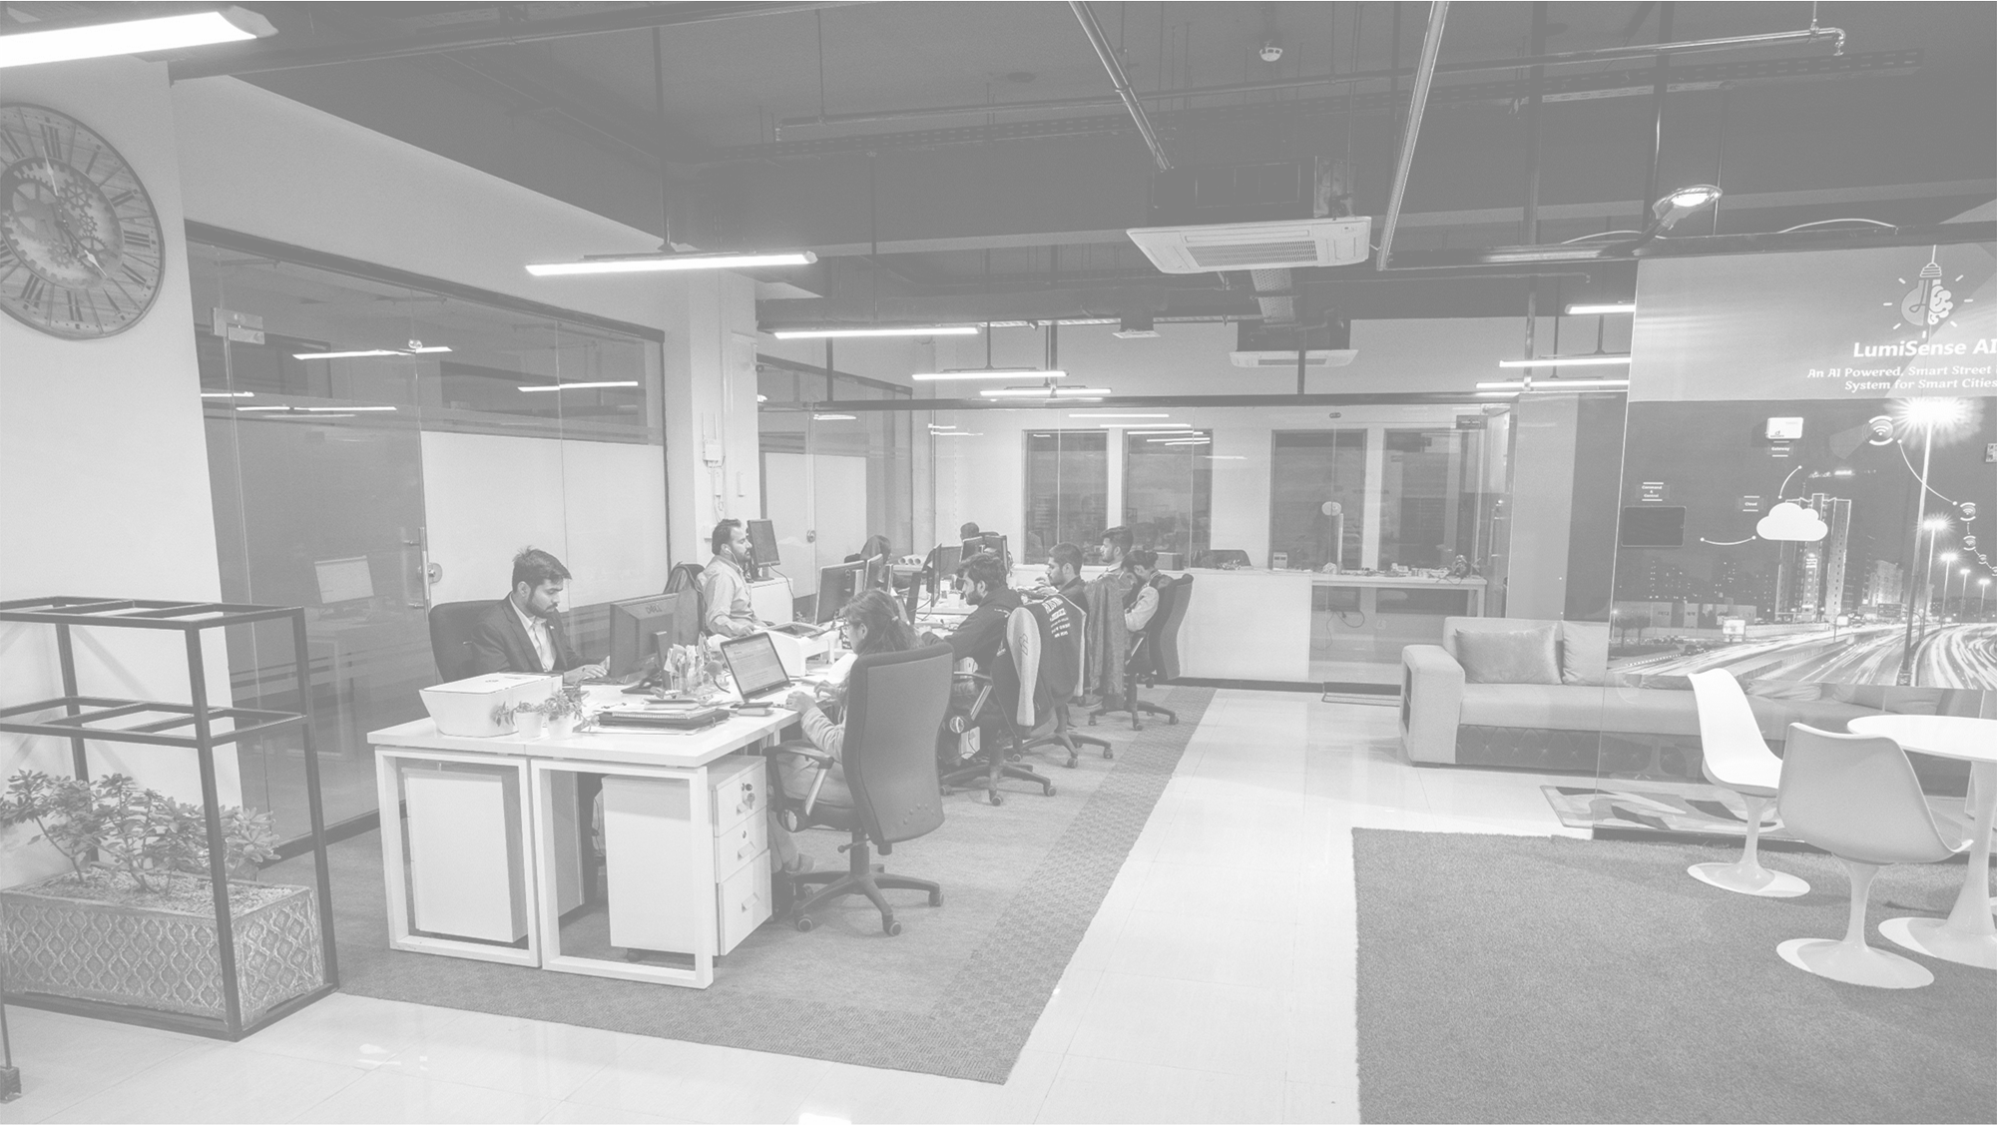

MULTI-DISCIPLINARY STRENGTH
  First of its kind in Pakistan
  Equipping the next generation of researchers with a cross-disciplinary blend of knowledge to create new knowledge and technologies
  Technologies identified for Phase 1:
    High Performance Computing
    Artificial Intelligence & Deep Learning
    Nanoscience & Nanotechnology
    Biotechnology
SCHOOL OF INTERDISCIPLINARY ENGINEERING & SCIENCES
26 labs from 9 NUST Institutions under one roof​

Slide 16
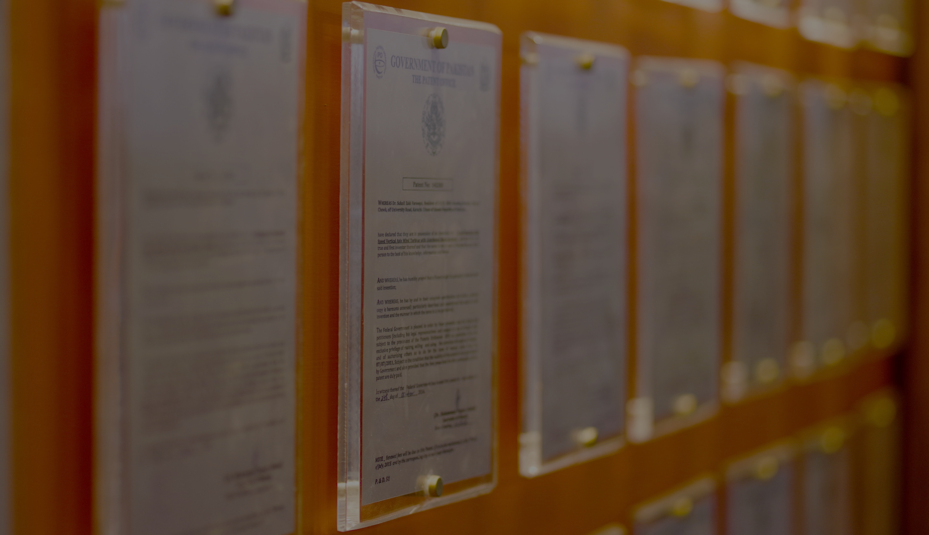

NUST INTELLECTUAL PROPERTY RIGHTS
First university in Pakistan to establish Intellectual Property Office for IP life-cycle management in 2011
FILED 1000
Highest number of IPRs filed and awarded in Pakistani academia
LICENSED 70
IPRs licensed to industries as per international best practices
CONTRIBUTION TO KNOWLEDGE ECONOMY
1st PAKISTANI UNIVERSITY
to transfer technology to industry
AWARDED 200
Including international IPRs:
7 US
1 Korean
1 Patent Cooperation Treaty (PCT)
Notes:
In order to protect the innovative work of its researchers, NUST lays very special emphasis on Intellectual Property. NUST established the first academia-based IP office, in 2011, for IP lifecycle management.
Till date, 890 IPRs have been filed, out of which 160 have been awarded (including 151 local and 9 international patents).
It is a matter of pride for us that we have the largest number of patents filed and awarded amongst Pakistani universities.

Slide 17
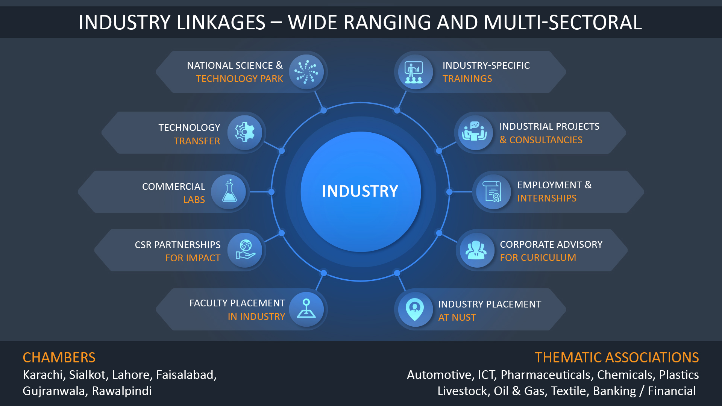
830+ PARTNERS
Notes:
NUST collaborates with various facets of Industry for various purposes:
NUST Professional Development Centre provides Industry Specific trainings to professionals.
Curriculum review & improvements are held on continuous basis by taking valuable input of the industry so as to make relevant industry problems part of university curriculum.
NUST offers state of the art labs & facilities to industry, which Industry can use for their research purposes.
NUST Placement Office works with Industry for student employment & internships. NUST is the only university to offer 100% internships to its Undergrad students.
Similarly NUST works with Industry for mutually beneficial collaborative research projects.
In order to connect with various industries in the sectors as flashed on the screen, NUST connects with Chambers of Commerce of Karachi, Sialkot & various other cities, in order to be able to get well connected with industries.

Slide 18





NUST Entrepreneurial Ecosystem
Pioneers in university-based incubation
The largest incubation space in Pakistan
3 credit hour course on Entrepreneurship
Graduated
Companies
Knowledge
Workers
Incubated
Companies
126
1500+
63
Female-led
Startups
Contribution to
National Economy
17%
$7M+

Slide 19
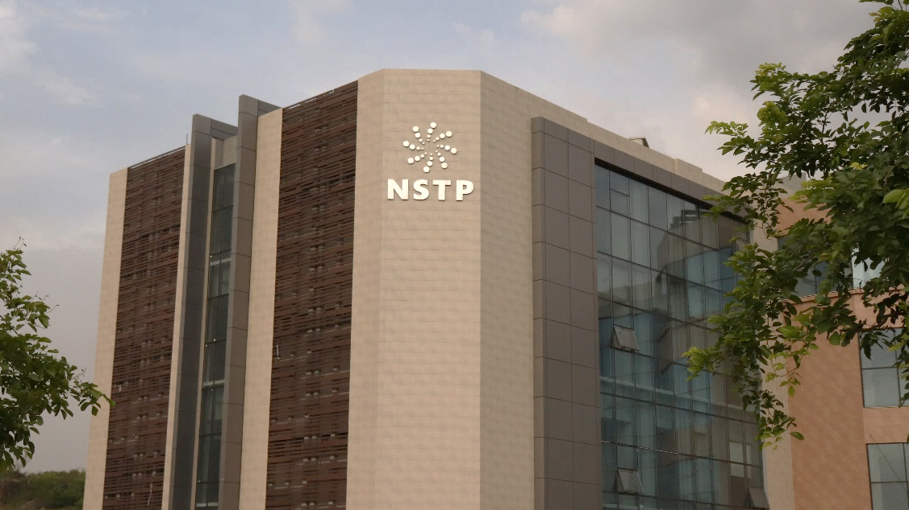
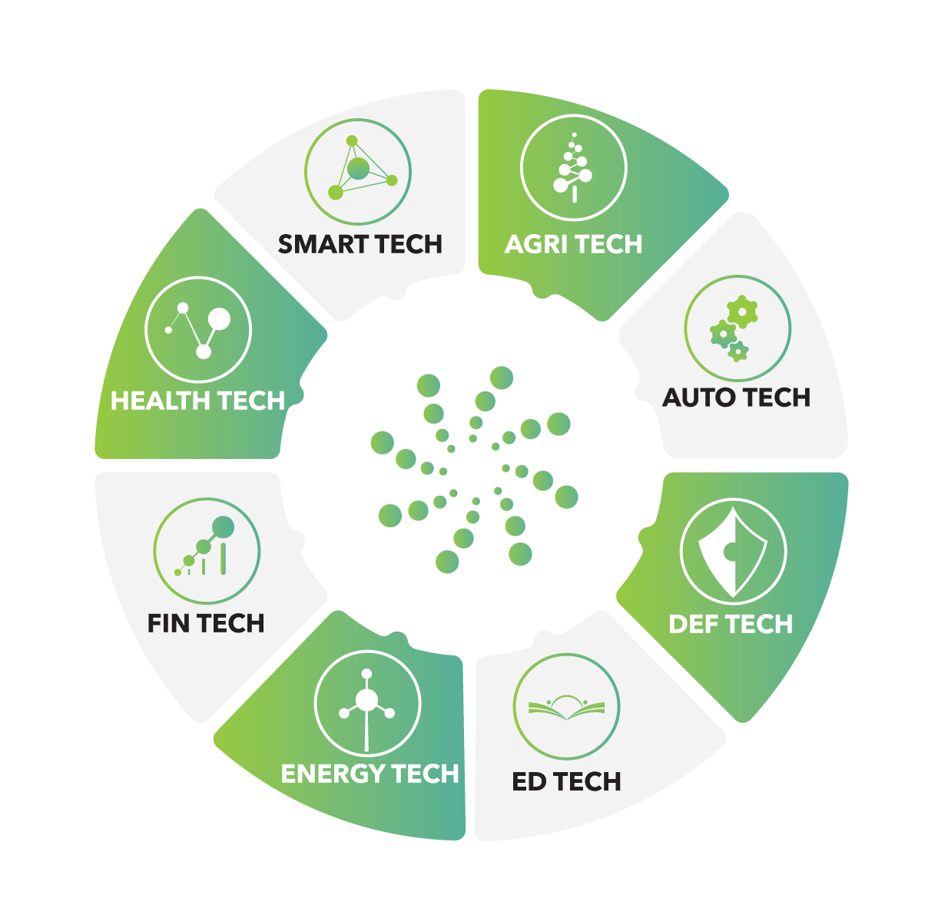
NATIONAL SCIENCE AND TECHNOLOGY PARK
Pilot Project Inaugurated Dec 9, 2019
101 Hi-tech companies on board –
  41 Anchor tenants and SMEs
  60 Startups
  10 MNCs from 7 Countries
8 Thematic Sectors
High-tech Special Economic Zone (SEZ) - 2020
Notes:
The National Science & Technology Park (NSTP) is our flagship project, which envisions to promote the neglected academia industry collaboration and there is no Science and Technology Park in the country as yet (restricted to only IT park). NSTP houses large and small organisations, R&D centres, multinationals, Small & Medium Enterprises (SMEs), and start-ups.
60 hi-tech companies on board - Anchor tenants, SMEs, Startups
23 industries, 34 startups
10 International tenants from 7 countries

Slide 20


NUST Institute
of Policy Studies (NIPS)
Notes:
Photo by Jean-Philippe Delbergheon Unsplash

Slide 21
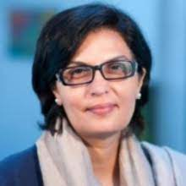
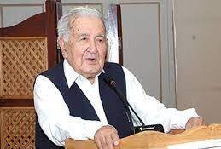
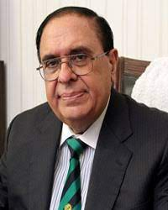
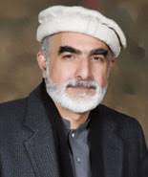

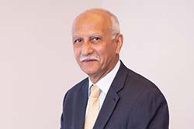
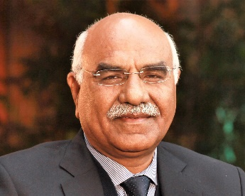
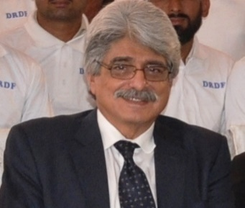
NIPS Advisory Council
NIPS AT A GLANCE
“NIPS performs world class knowledge diplomacy and contributes to comprehensive knowledge development through evidence-based original and expert inputs to policy formation and processes”
Dr. Sania Nishtar
Senator
Engineer Shams-ul-Mulk
President Ghulam Ishaq Khan University, Former Chairman WAPDA, Chairman SPDI
Dr. Atta-ur-Rehman Chairman of Pakistan Science and Technology Task Force
Owais Ahmad Ghani
Former Governor Khyber Pakhtunkhwa & Balochistan
Ambassador Riaz Khokar
Former Foreign Secretory of Pakistan
Lt Gen Masud Aslam (Retd) Former Commander 11 Corps
Dr. Muhammad Amjad Saqib
Founder and Chairman Akhuwat Foundation
Dr. Salman Shah
Advisor to CM Punjab Economic Affairs and Planning
Research Areas
Economy, Governance and Socioeconomic Development
Policy formulation for knowledge economy and Science Parks
CPEC and Belt & Road Initiative
Water, Energy and Environment
IR, Geopolitics and Security
Notes:
1- NIPS aspires to fulfil the following objectives: -
Policy intervention / advocacy in key domains of national importance. Bridging the gap between knowledge and policy formulation.
Identification of projects for socio economic development having national impact.
Promotion of academia-industry linkages including technologies for high end strategic R&D in the field of Artificial Intelligence, Robotics, Nanotechnology, IT, Cyber Security, Biotechnology and Energy technologies.
Provision of knowledge-based inputs for the development of NSTP leading to the eventual establishment of a world-class techno polis involving the participation of key public and private sectors.
2- NIPS Advisory Council consists of eminent multi-sectoral stakeholders to provide high-level advice and guidance to the functioning of NIPS. They have been selected to underscore the fact that NIPS celebrates diversity of opinion and excellence as its core values and they are as follows: -
Dr. Sania Nishtar, Special Assistant to the Prime Minister on Social Protection and Poverty Alleviation
Engineer Shams ul Mulk, President Ghulam Ishaq Khan University, Former Chairman WAPDA
Dr. Atta ur Rehman, Chairman Prime Minister Task Force on Science & Technology
Owais Ahmed Ghani, former governor of the Khyber Pakhtunkhwa province of Pakistan,
Ambassador Riaz Khokhar, Former Foreign Secretary of Pakistan
Lieutenant General Muhammad Masood Aslam (Retd.). Former Commander 11 Corps
Dr. Salman Shah, Advisor to Chief Minister Punjab, Former Finance Minister
Dr. Muhammad Amjad Saqib, Founder and Chairman, Akhuwat Foundation

Slide 22

SOCIO-ECONOMIC DEMOGRAPHICS OF STUDENTS

Slide 23
SOCIO-ECONOMIC DEMOGRAPHICS OF STUDENTS
Lower | Monthly Income below PKR 40,000
Lower Middle | Monthly Income PKR 40,000 – 80,000
Middle | Monthly Income PKR 80,000 – 125,000
Upper | Monthly Income beyond PKR 125,000
Approximately 60% of the students face financial constraints with monthly family income less than PKR 80,000
Notes:
Socioeconomic Demographics of Students (slide can be skipped)
More than 60% of students at NUST have family incomes less than Rs. 80,000 per month.
And 17% students have monthly family incomes less than Rs. 40,000
NEED Initiative
NUST has made a commitment to support students who get admission on merit but cannot afford to get through their education because of financial constraints.
NEED initiative is short for NUST Endowment for Educational Development, aimed to make quality education available at affordable price for inclusive growth, and help NUST become a need-blind university.
1.6 Billion PKR already disbursed in the last 8 years. 1662 students have already benefitted from NEED Initiative.

Slide 24
NUST ENDOWMENT FOR EDUCATIONAL DEVELOPMENT (NEED)
Currently, as many as 2058 students are availing scholarships
NUST aspires to be a need-blind university
206 endowment seats are made permanently free, while we are aiming to reach the target of 400 seats in Phase 1 (Need blind target - 1600 seats in total during 4 phases)
Notes:
More than 60% of students at NUST have family incomes less than Rs. 80,000 per month.
And 17% students have monthly family incomes less than Rs. 40,000
(Upper income group: > PKR 125,000; Middle income group: PKR-80,000-125,000; Lower middle income group: PKR 40,000-80,000; Lower income group: < PKR 40,000)
NEED Initiative
NUST has made a commitment to support students who get admission on merit but cannot afford to get through their education because of financial constraints.
NEED initiative is short for NUST Endowment for Educational Development, aimed to make quality education available at affordable price for inclusive growth, and help NUST become a need-blind university.
PKR 1.6 Billion already disbursed in the last 8 years. Currently 1864 NUST students are studying on need-based scholarships.

Slide 25
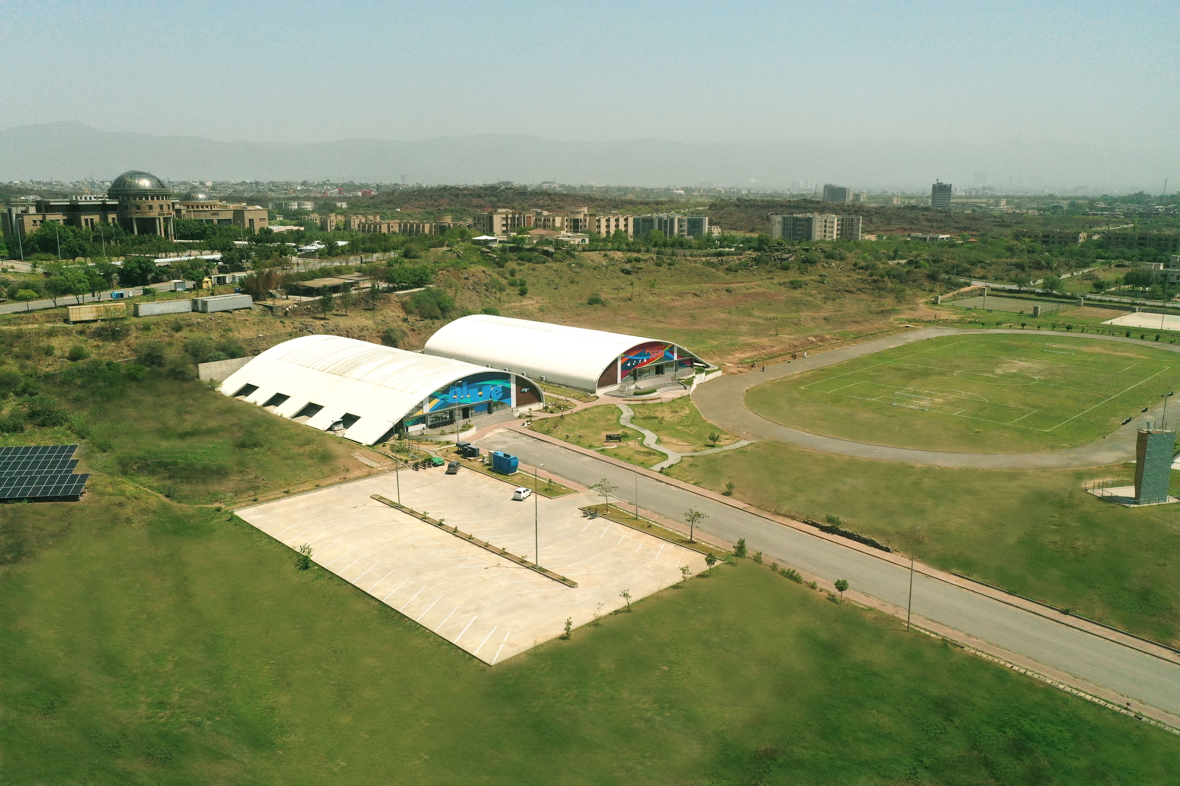
Life on campus
Central library
On-Campus housing and dining
Pick and drop service, super mart
Health & well-being centre
On-campus electric cars
Horse-riding club
All weather swimming pool
Bowling Alley
Squash & Tennis courts
Clubs & societies
24/7 counselling & advisory services
Notes:
Mahtab
A sprawling Sports Complex, spread over a total area of 285,266 sq. ft., is under construction at the H-12 campus – it will provide male & female gymnasiums, a bowling alley, indoor tennis and badminton courts, a skating ring, and a swimming pool, open for use by students, faculty, staff, alumni & their families.

Slide 26
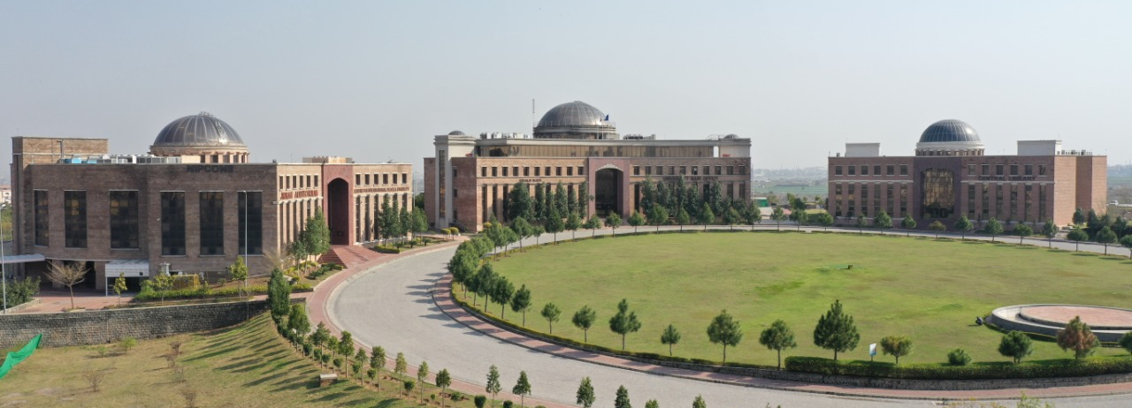

THANK YOU

